Slide 1
Deep Learning and Neural Networks

Slide 2
Kahoot.it
Pin:

Slide 3
What is Deep Learning?

Slide 4
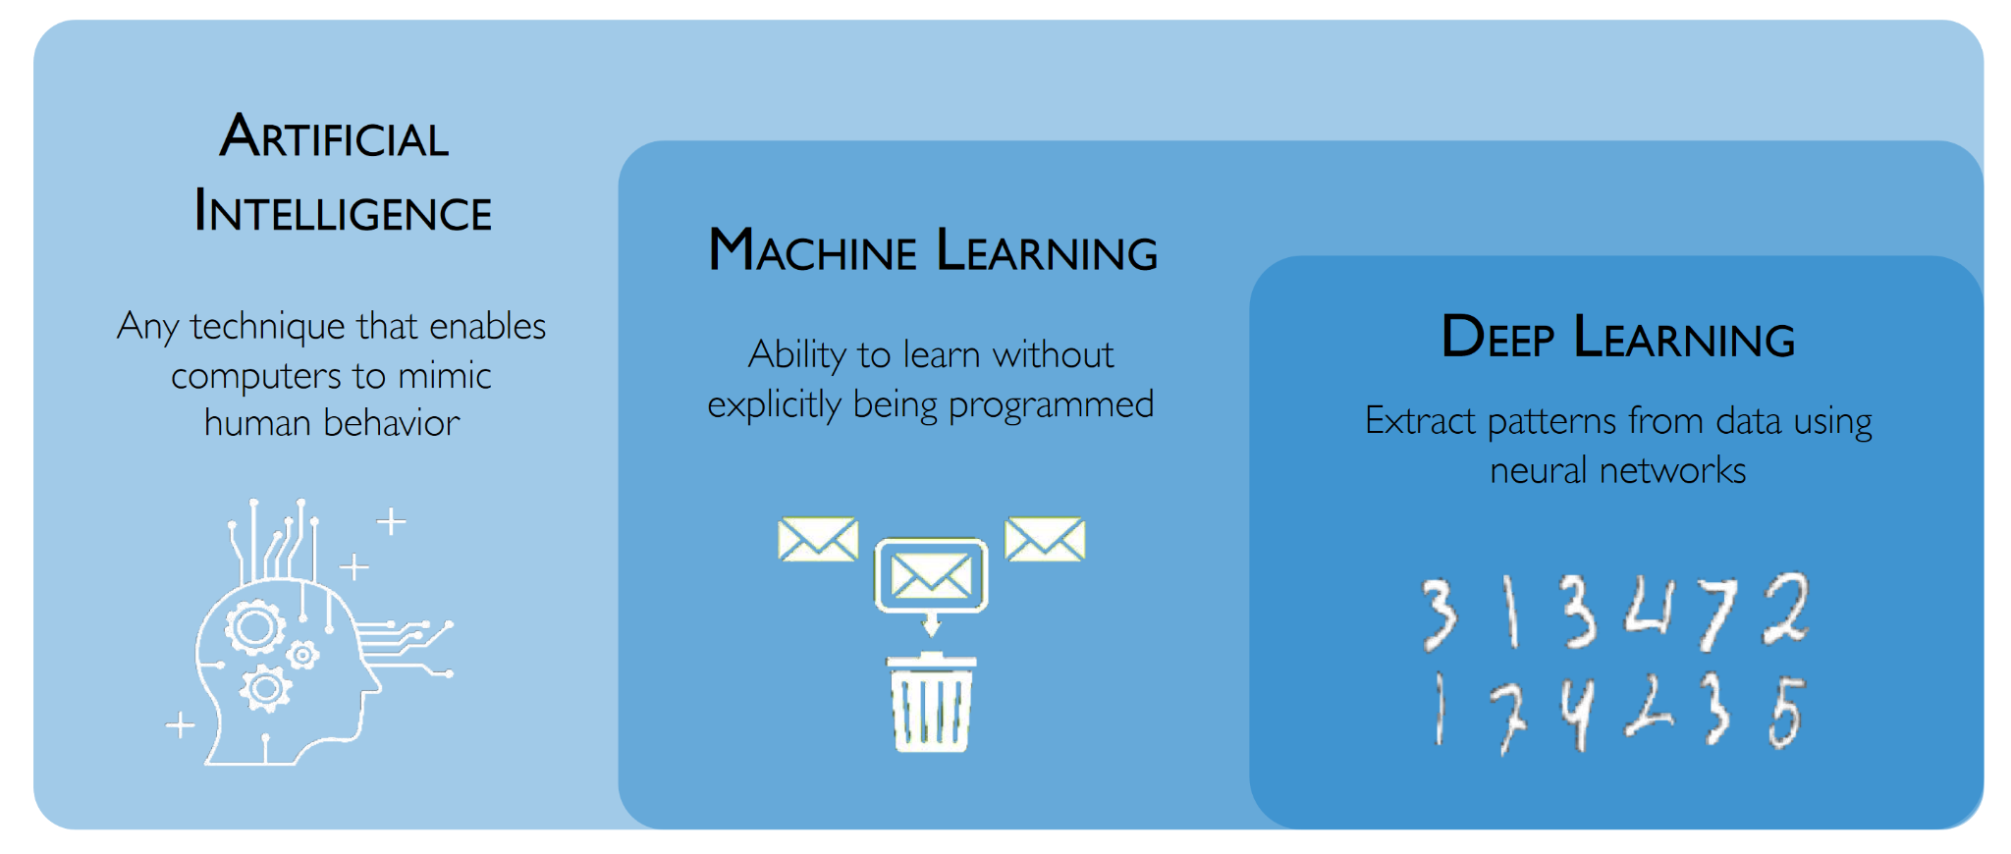
What is Deep Learning?

Slide 5
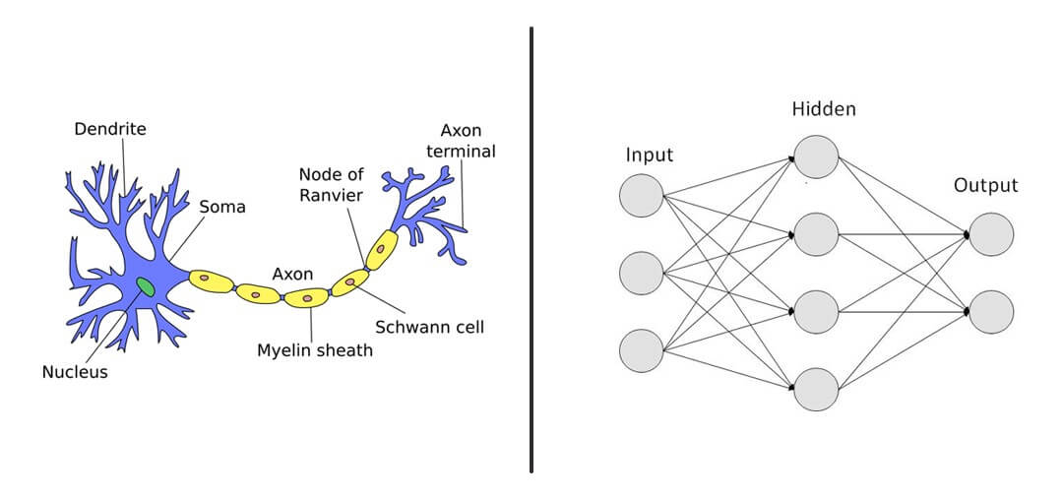
Biological vs Artificial Neural Networks
Biological
Dendrites
Synaptic Weights
Axons
Action Potential
Artificial
Inputs
Weights
Outputs
Activation Function

Slide 6
Math Review

Slide 7
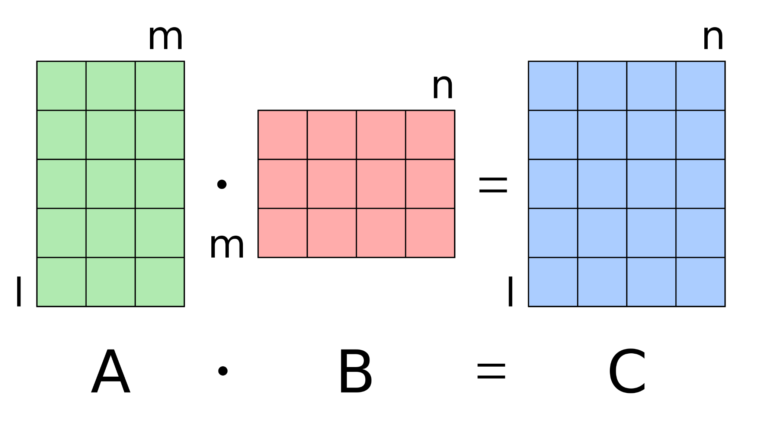
Matrix Multiplication

Slide 8
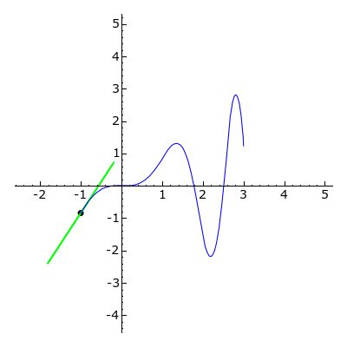
Derivative

Slide 9

Gradient

Slide 10
The Perceptron

Slide 11
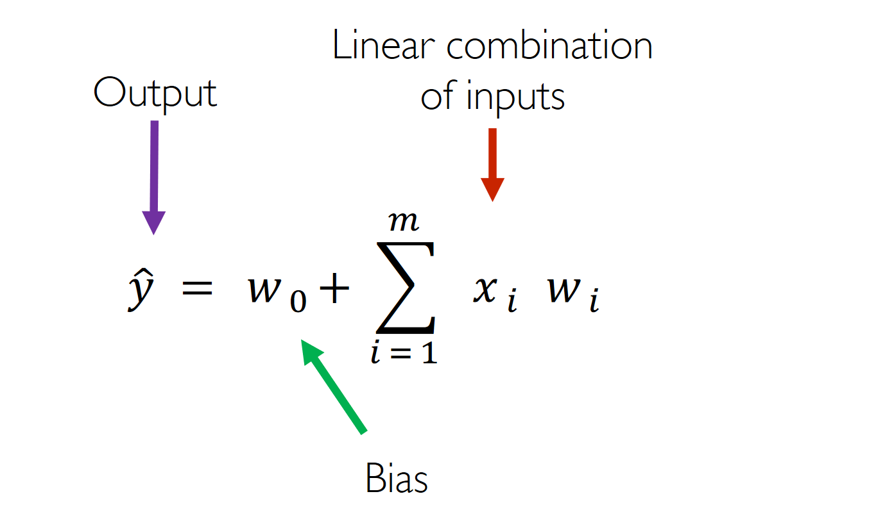
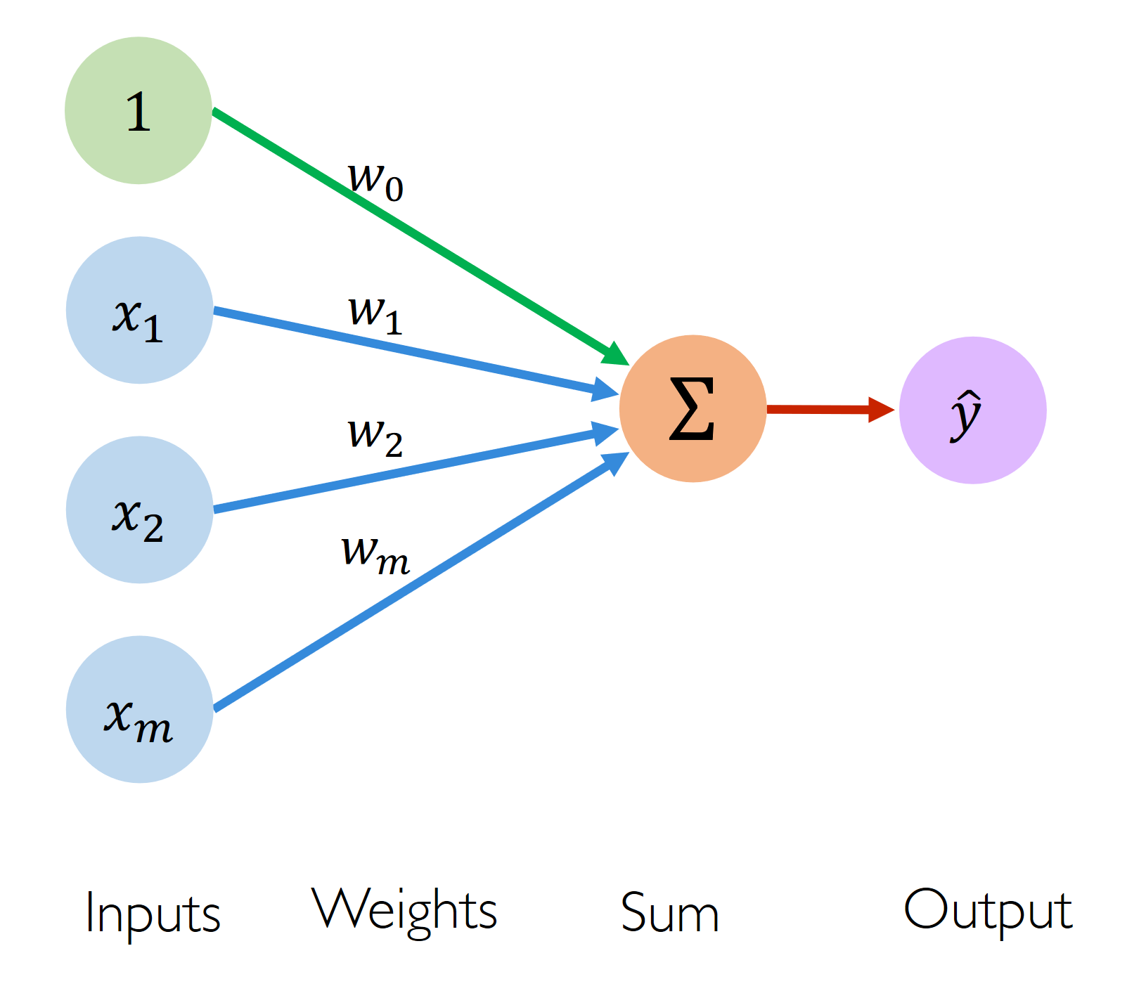
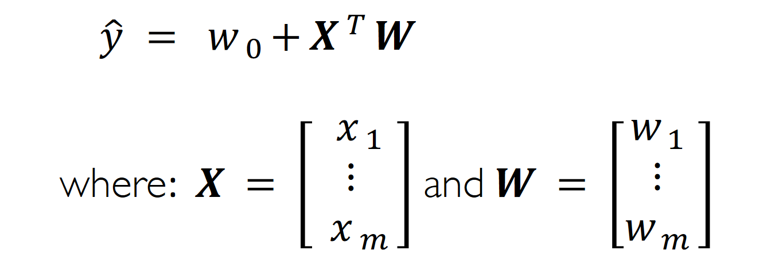
Perceptron

Slide 12
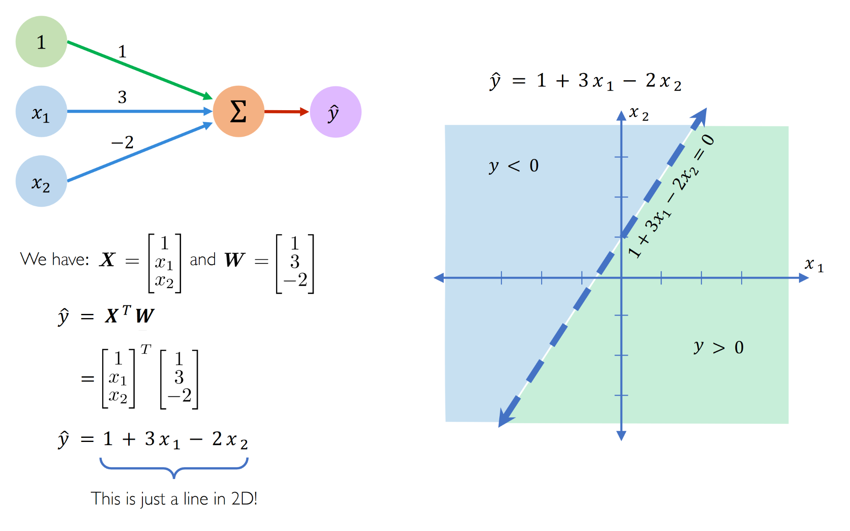
Perceptron Example

Slide 13
Neural Networks

Slide 14
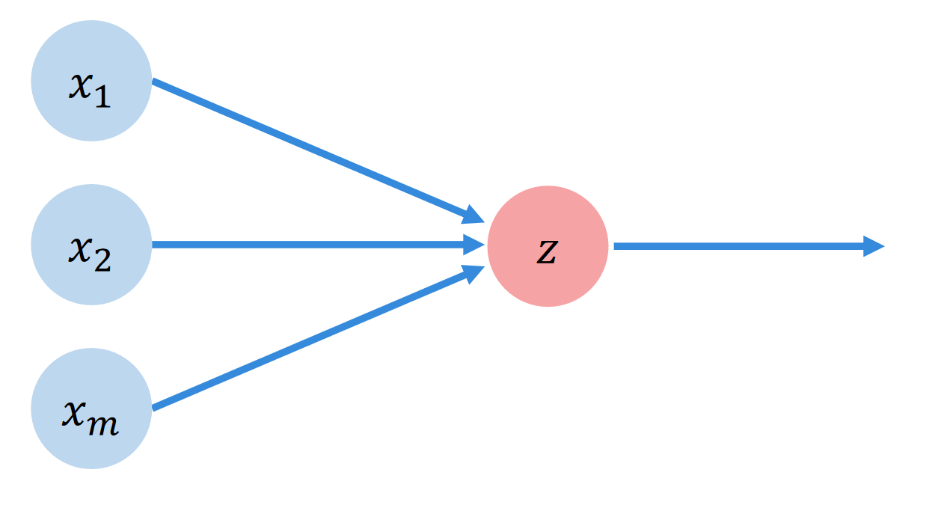
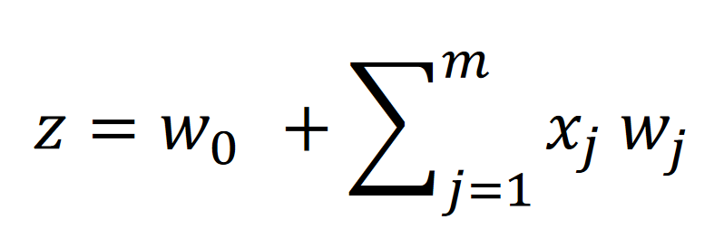
Generalizing the Perceptron

Slide 15
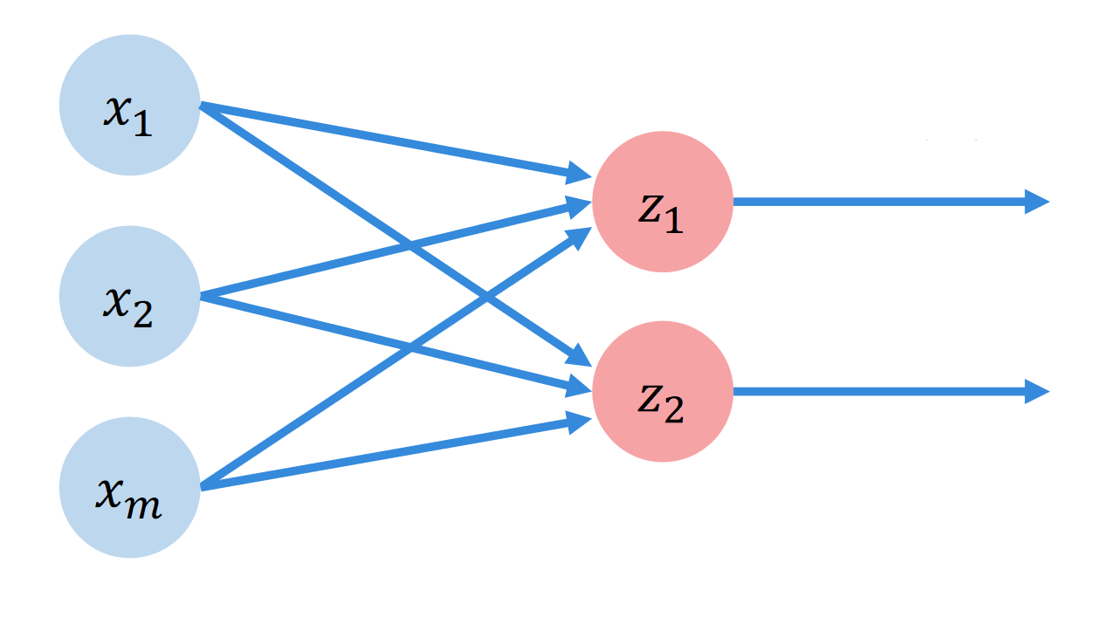
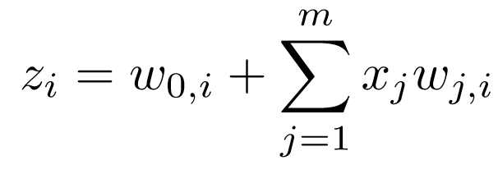
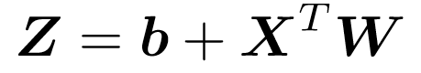
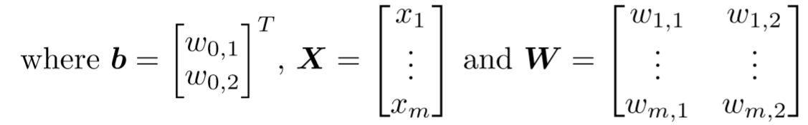
Generalizing the Perceptron

Slide 16
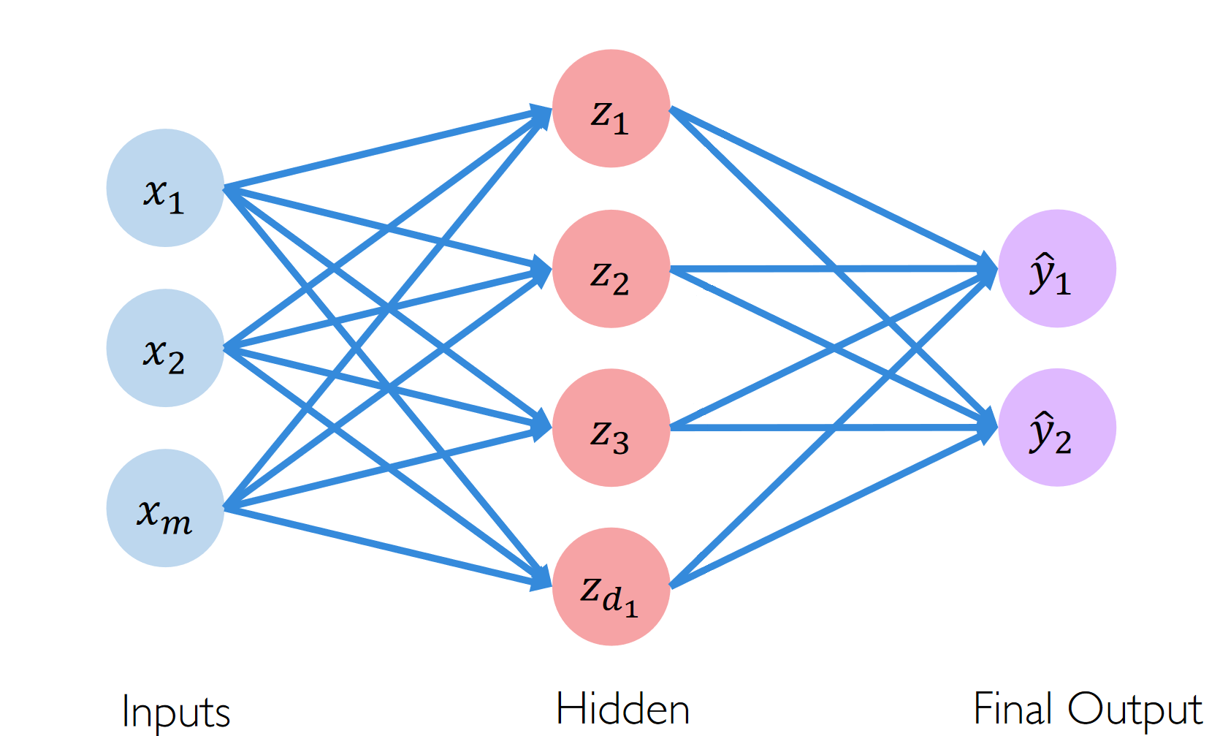
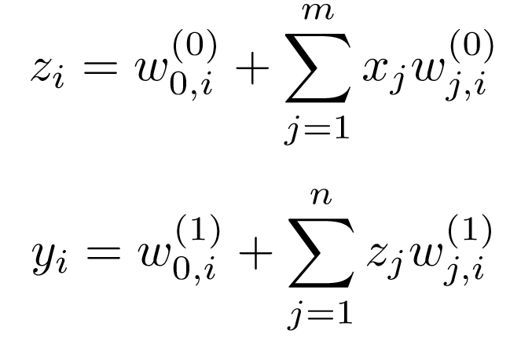
Single Layer Neural Network

Slide 17
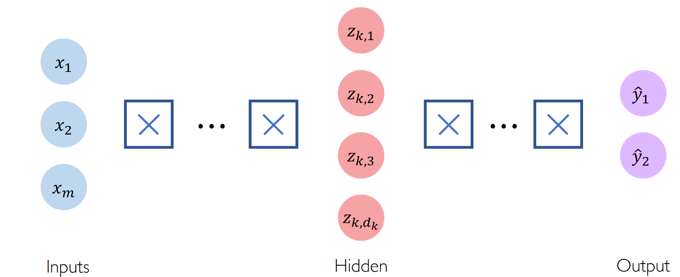
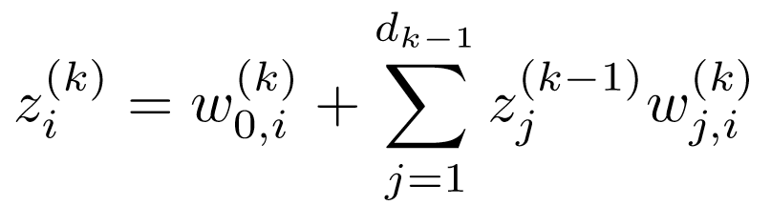
Neural Networks

Slide 18
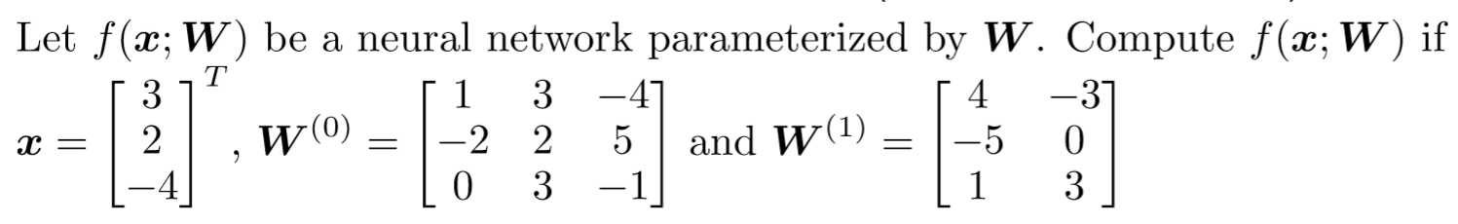
Neural Networks Example

Slide 19
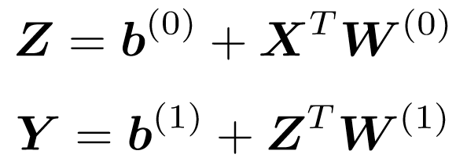
What is the Problem?
Hint:

Slide 20
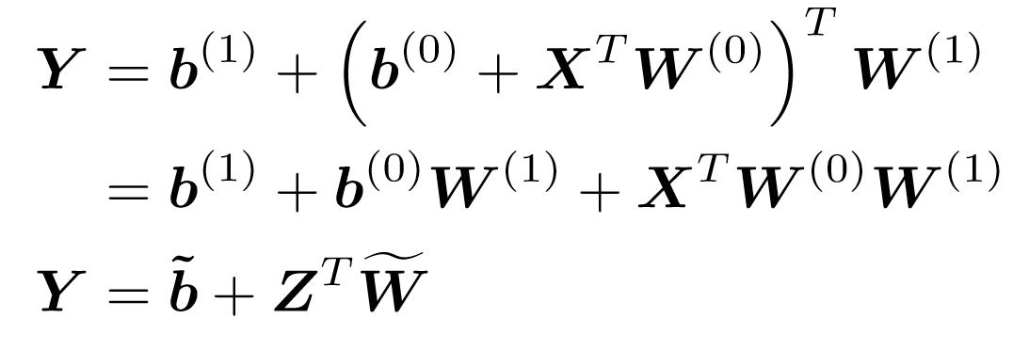
What is the Problem?
Hint:
Answer:

Slide 21
Activation Functions

Slide 22
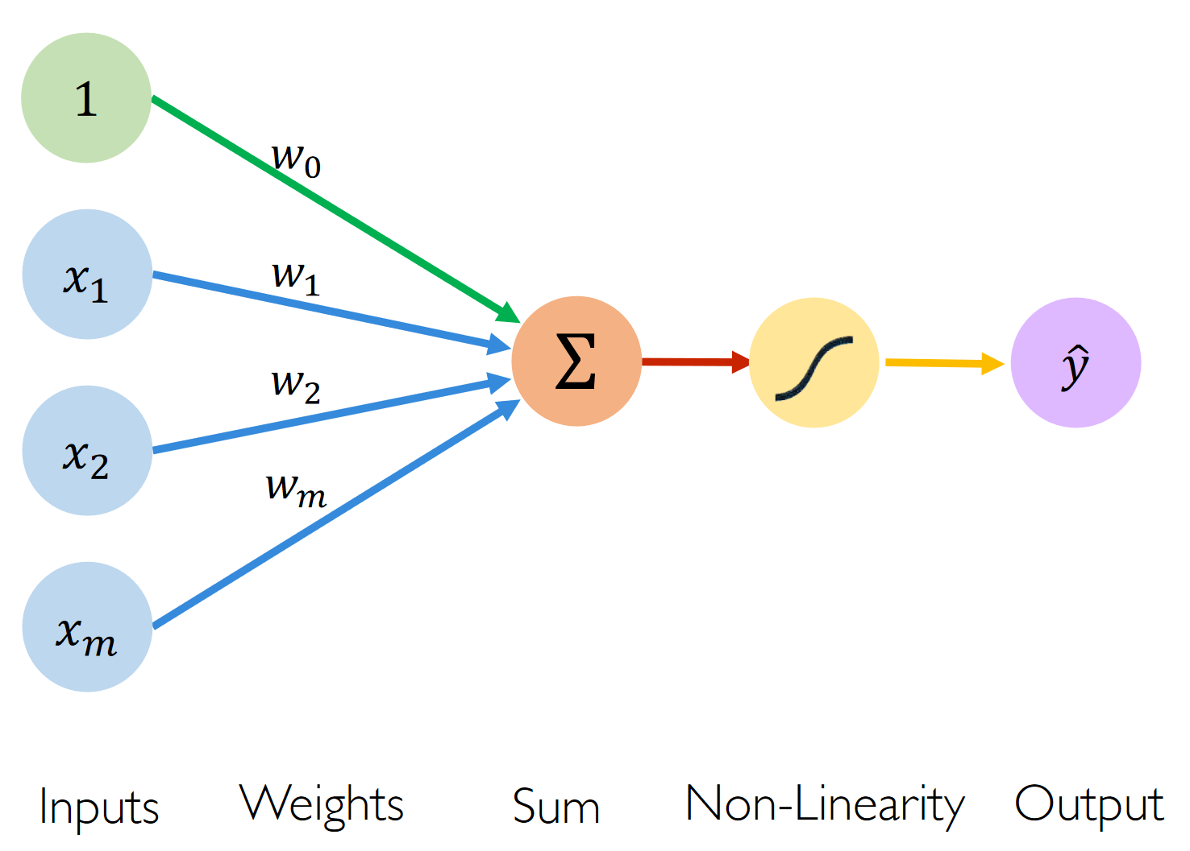
Perceptron Revisited

Slide 23
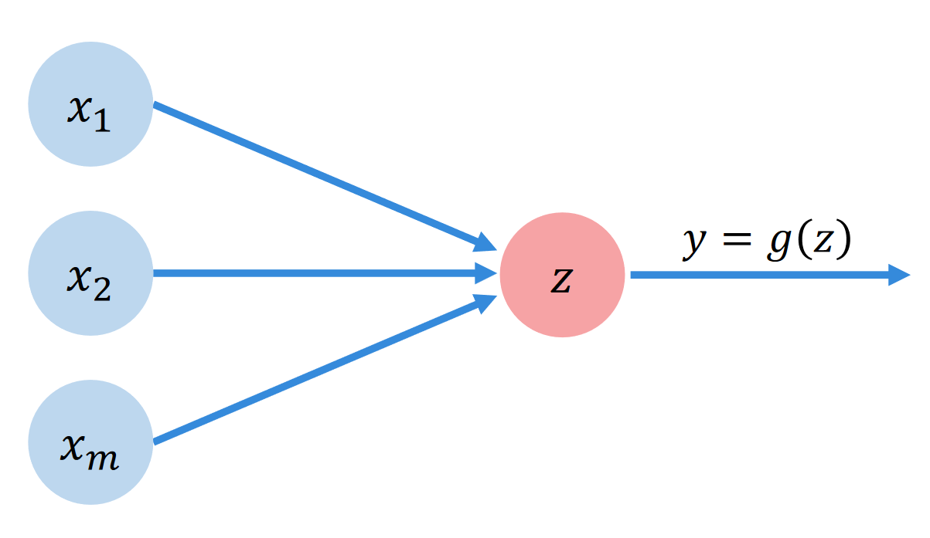
Perceptron Revisited

Slide 24
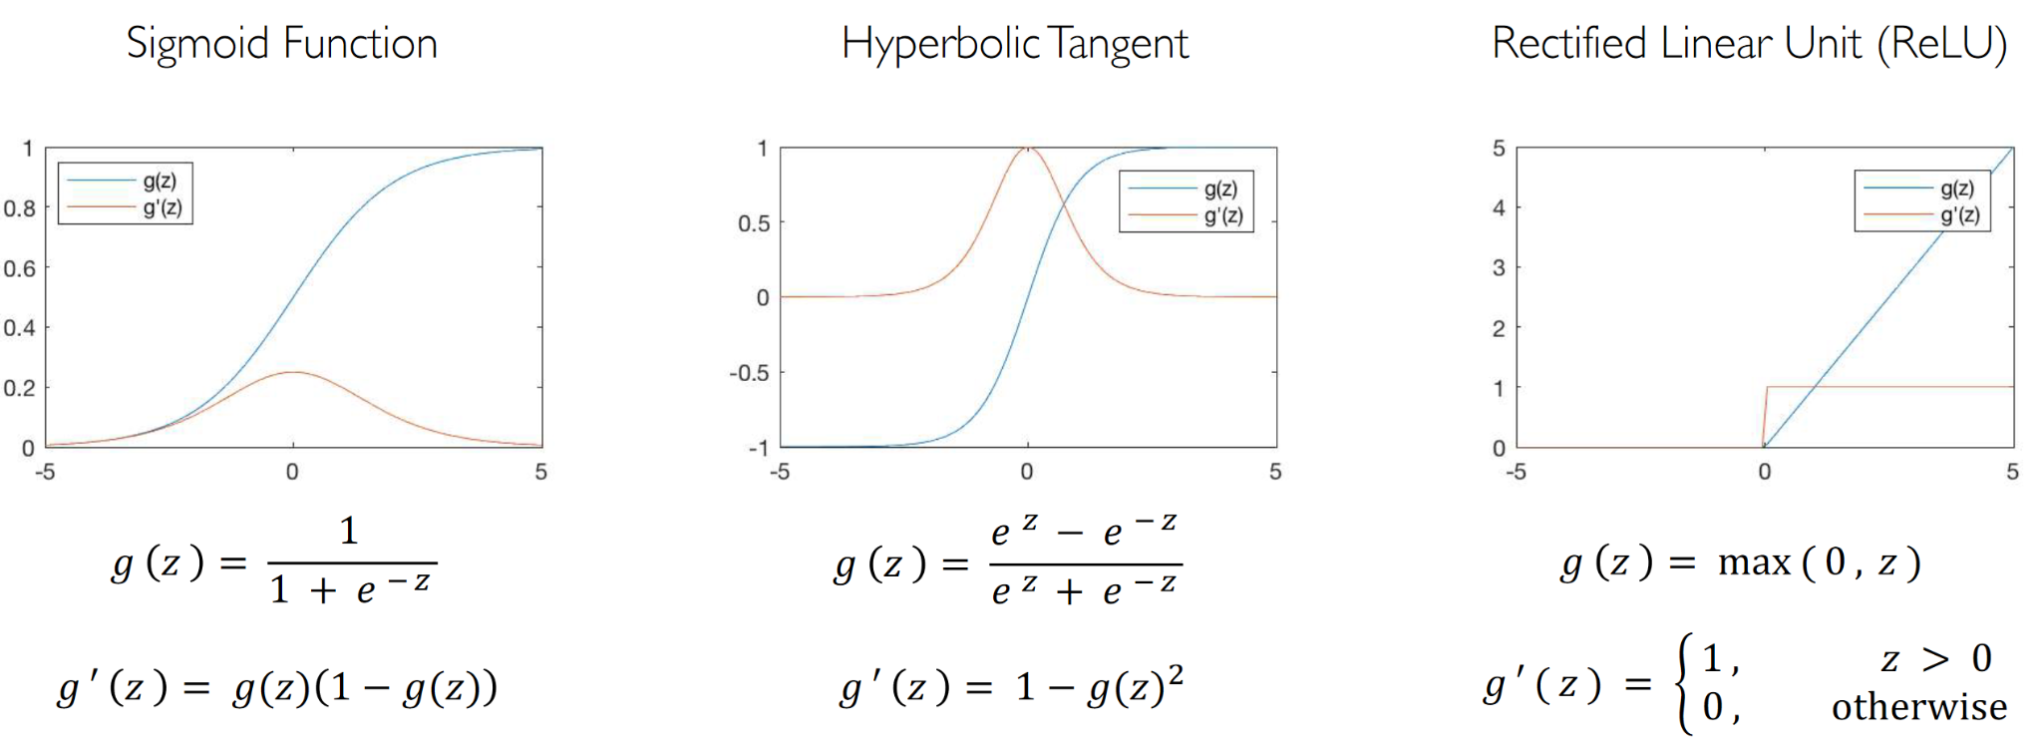
Activation Functions

Slide 25
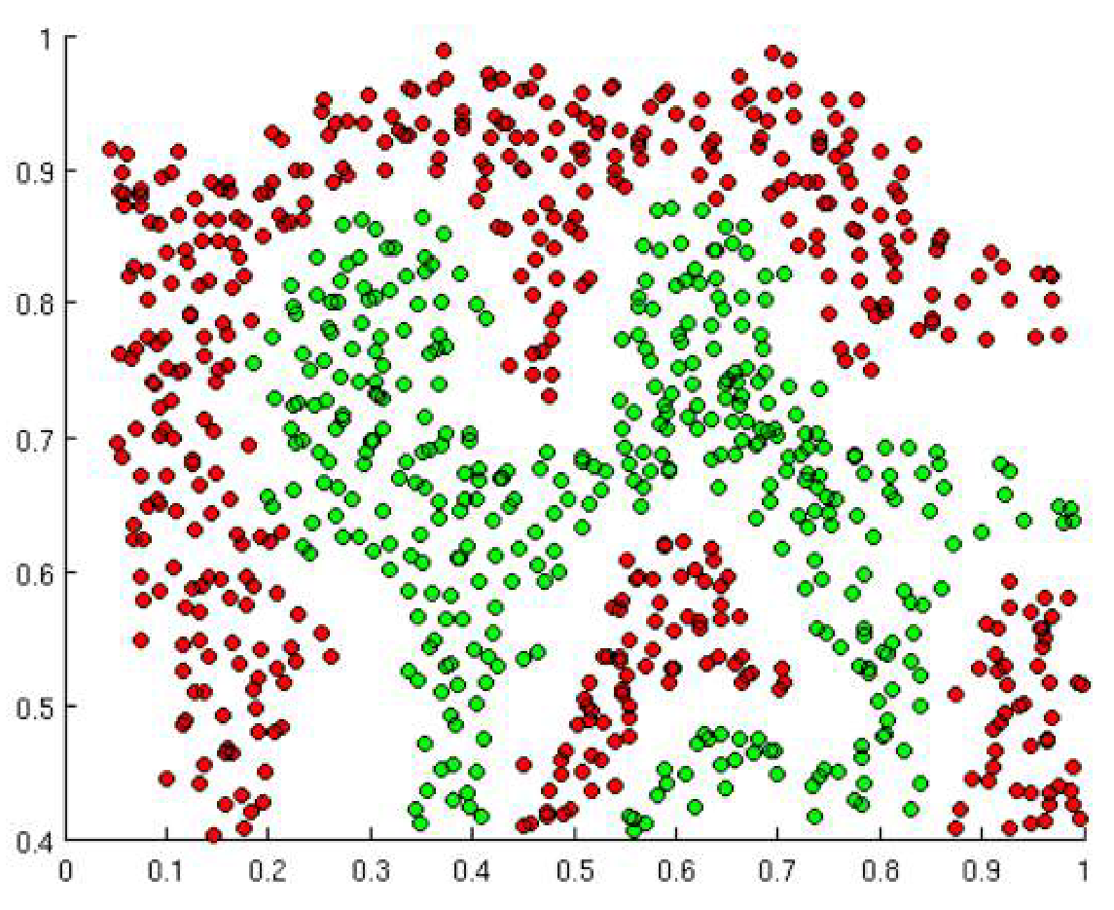
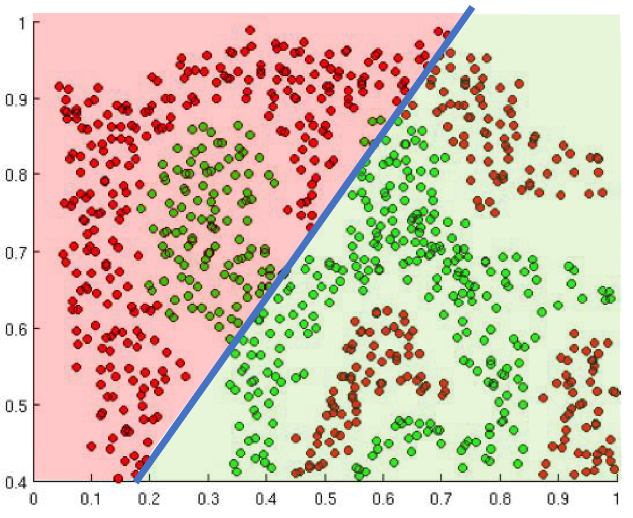
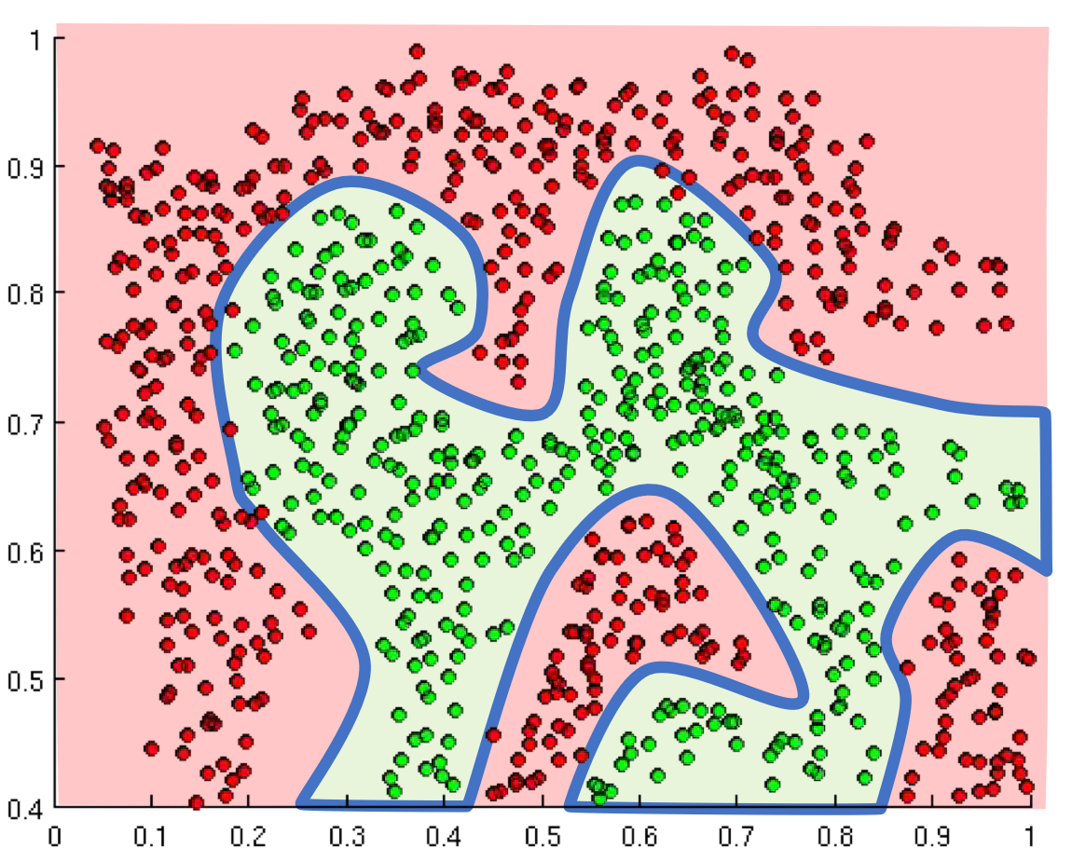
Activation Functions

Slide 26
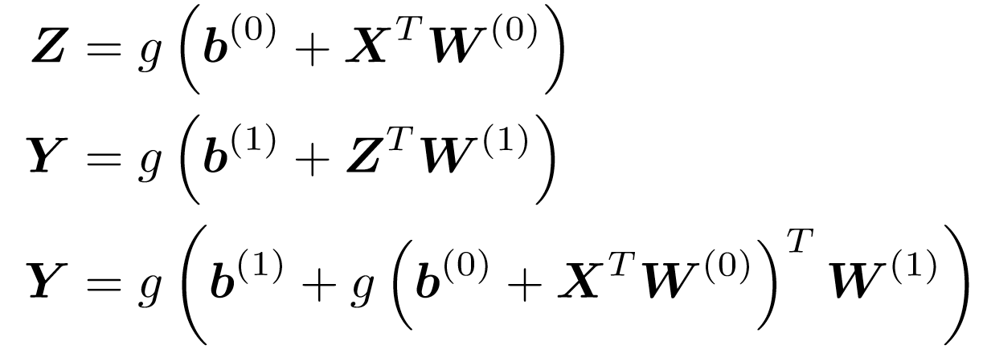
The Problem Revisted

Slide 27
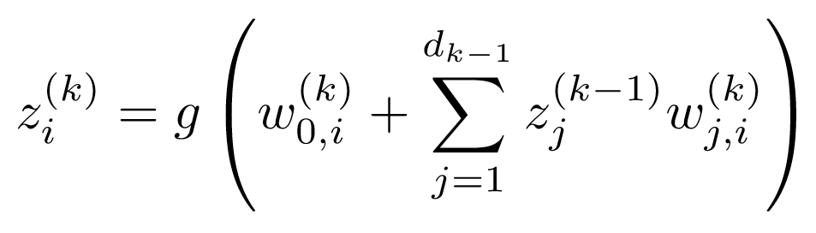
A Complete Picture Neural Networks

Slide 28
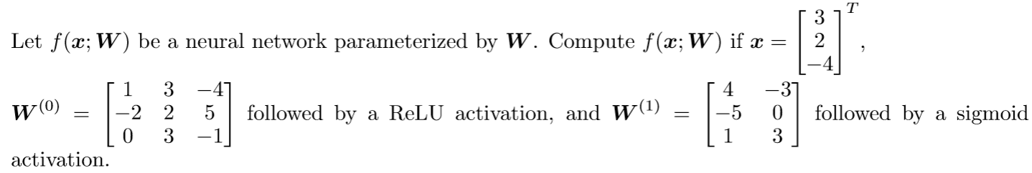
Complete Example

Slide 29
Loss Functions
Notes:
Loss functions are bread and butter of neural networks.
They help us evaluate how well a neural network is doing.
This is very similar to how a teacher might score your grades in school. They compare how far your answers are to the correct expected answer.
Since we want neural networks to learn, we need to measure their performance based on some metric, and guide them towards making better and better predictions.

Slide 30
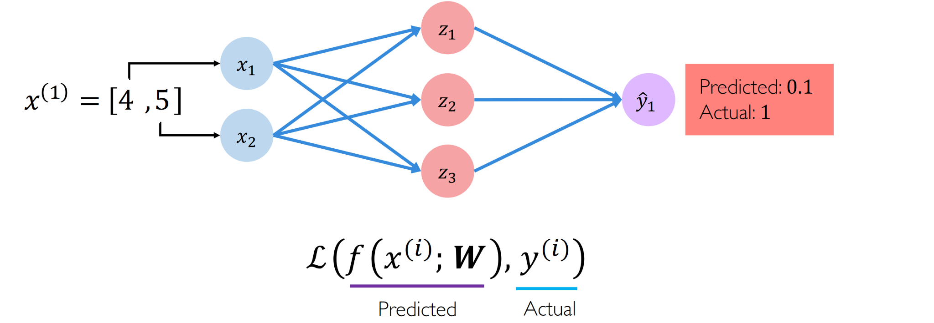
What is a Loss Function?
Notes:
The idea is very simple.
This is a simple neural network, you’ve seen this before.
Suppose the network’s inputs are 4 and 5
You run a forward pass
and you make a prediction
Now suppose that you predict 0.1
And the ground truth label, the actual value, is 1
Then your loss is a function of your predicted and actual values
Can someone guess what this first function resembles? It is your model that takes in inputs and weights.
okay so this basically is loss (model output, and ground truth)
Are you guys with me so far?

Slide 31
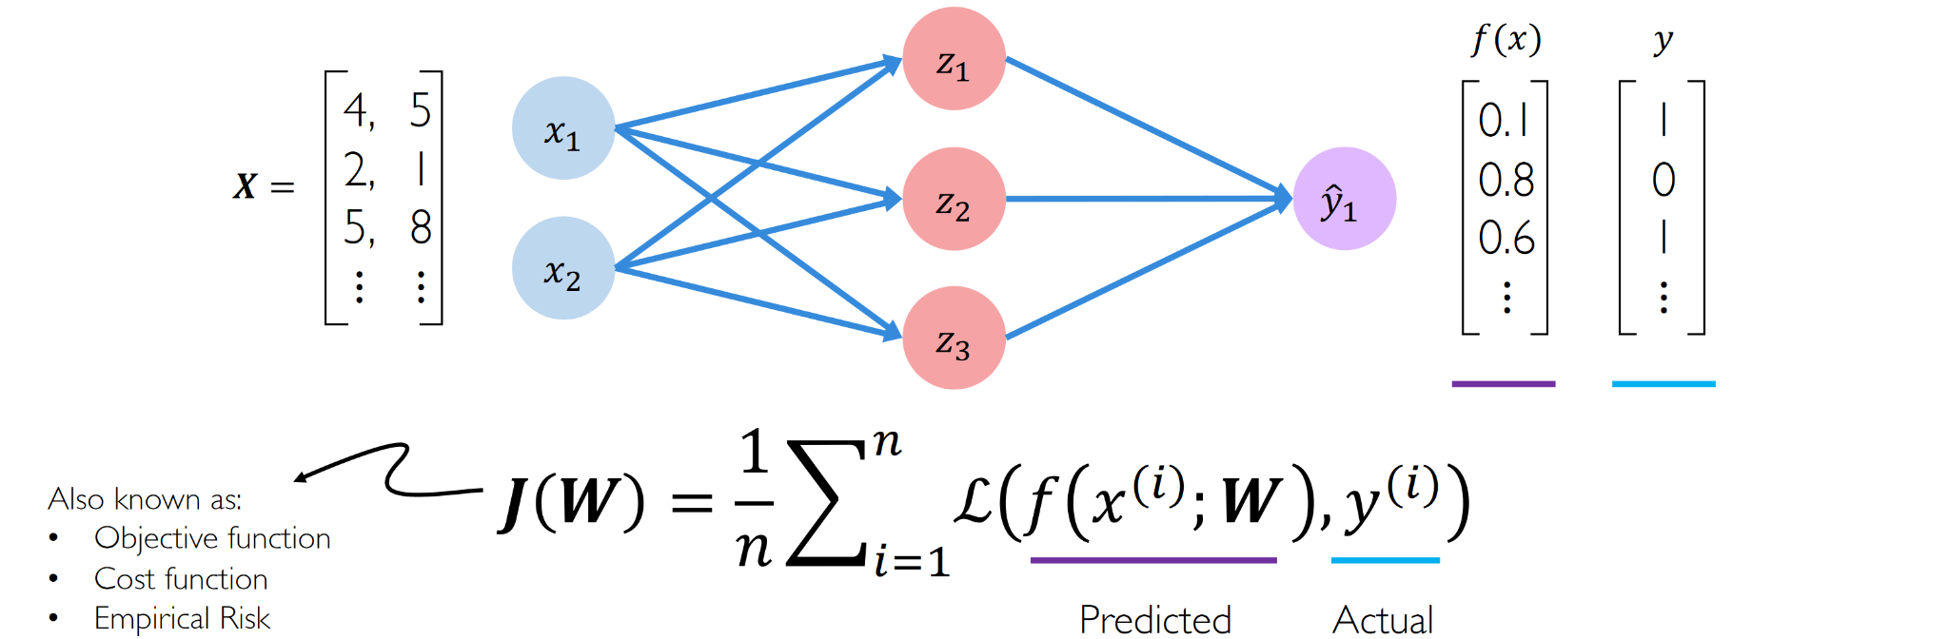
Empirical Loss
Notes:
Now instead of a single input 4 and 5
you have a multi dimensional input
and instead of a single output you get a vector of outputs from the model for each of these inputs
and you have the ground truth labels for each of them
then you can define can objective function, also known as cost function or empirical risk J(W) which is … I want you guys to help me out here
let’s break this down step by step, so we recognize the term inside, that’s our loss function, we saw that on the previous slide, right?
do you recognize this symbol here? can someone explain what it means?
alright, so it says take the sum from 1 to n
and this first term here 1/n divides the summation by n
what does this summation/n represent?
it represents an average
and its an average of what?
average loss
so generally the goal of your objective function is to try to pick weights W so that this entire average loss value is as small as possible
are you guys with me so far?

Slide 32
There are different kinds of loss functions
Notes:
Typically there are different kinds of loss functions and you might choose them depending on what problem you are trying to solve
We will see two kinds of loss functions which are commonly used

Slide 33
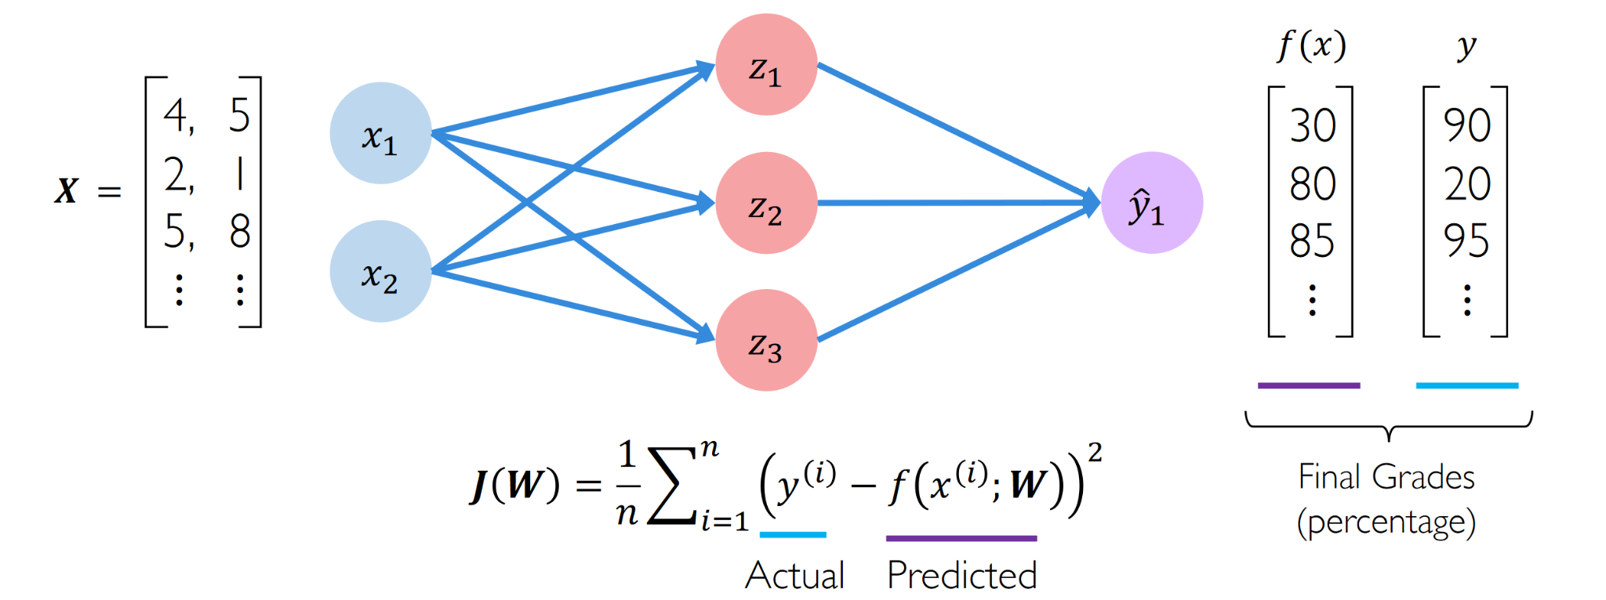
Mean Square Error Loss
Notes:
The first one is mean square error loss
This looks pretty similar to what we had before, does anyone want to explain what this might represent?
You are measuring distance in a way
So this loss function is typically used in regression problems
Can someone give me an example of what is a regression problem?

Slide 34
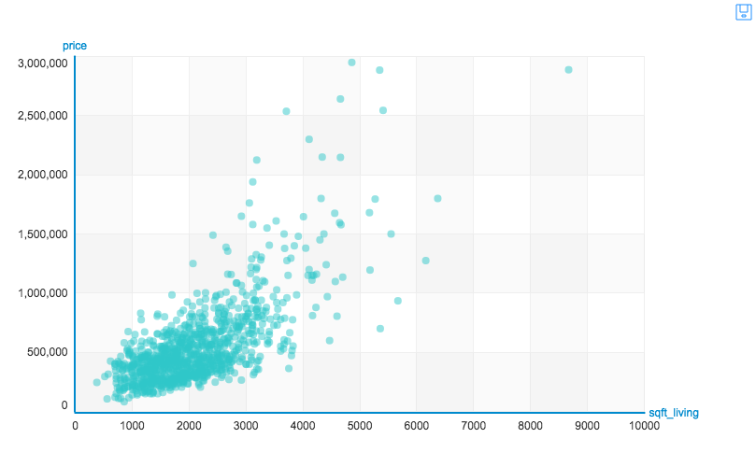
Notes:
Linear regression
Suppose that on y axis you had housing prices
And on X axis you had square footage
then your line of best fit is your mean squared error between the points
It gives you the distance each point is from the line
and tries to find the best fit -- best fit means a line such that these distances are minimum

Slide 35
Likelihood Loss
Model predictions p: [0.4, 0.6, 0.9, 0.1]
Ground truth y: [0, 1, 1, 0]
Likelihood = (y * p * (1 - y)* (1 - p))
= enter your answer in chat
Notes:
0.6 * 0.6 * 0.9 * 0.9 = 0.2916

Slide 36
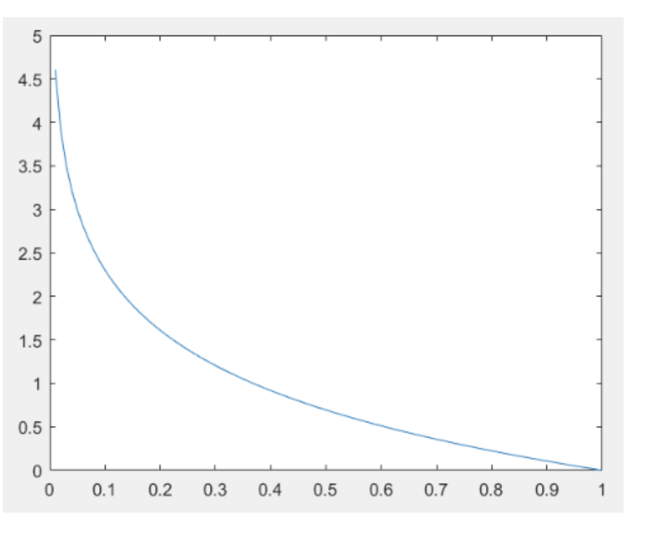
Likelihood = (y * p * (1 - y)* (1 - p))
Log Likelihood = -(y log(p) + (1 - y) * log(1-p))
Also known as cross entropy loss
Most commonly used for classification problems.
Notes:
This is the likelihood function in log space
Why do we consider the function in log space?
How many of you are familiar with the log function?
Can someone explain what happens to values on this graph? This is a representation of the log function, so can someone help me understand what the log function does?
It makes small values really small and large values really large, correct?
So this way, if your model predictions are very small values, then they will be pushed closer to 0, and if they are high values, they will be pushed to 1
This is typically used for classification problems
Can you guys answer in chat of an example of a classification problem

Slide 37
Pop Quiz
Enter your answer in chat
What is a loss function?

Slide 38
Training
Notes:
Alright so now we know how to do a forward pass,
compute the loss
but how do we teach the neural network that the answer is right or wrong?
For example, when your teacher evaluates your grades for a test, and gives you your score and tells you which answers are right, and which answers are wrong, you go back home and review the wrong answers, you update your knowledge about the wrong answers so that next time you get those answers right, correct?
How do we get the neural network to do the same thing?

Slide 39
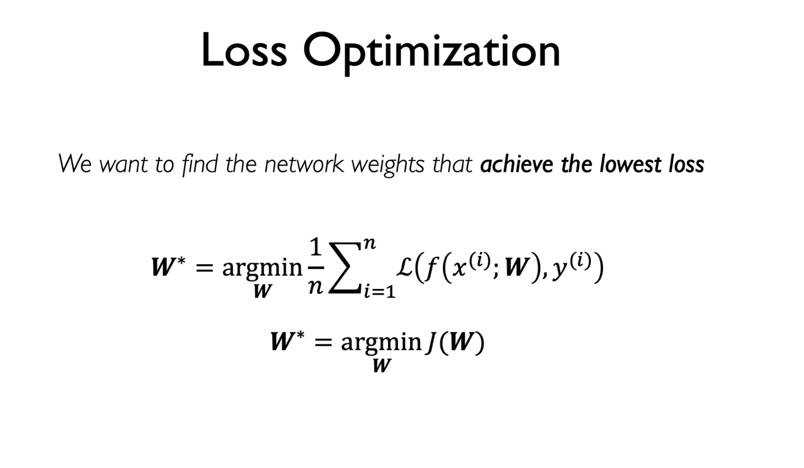
Notes:
In machine learning this concept is called loss optimization
we want to find the network weights that achieve the lowest loss
let’s unpack this
what is this W? its a weight matrix
now lets jump to this term inside, this is the average loss correct? this was the cost function J we saw before
so what this final statement says is that we want to pick a weight matrix W* such that it is the weight matrix which has the lowest J
can someone explain what is arg min here?
what is the difference between min and arg min?

Slide 40
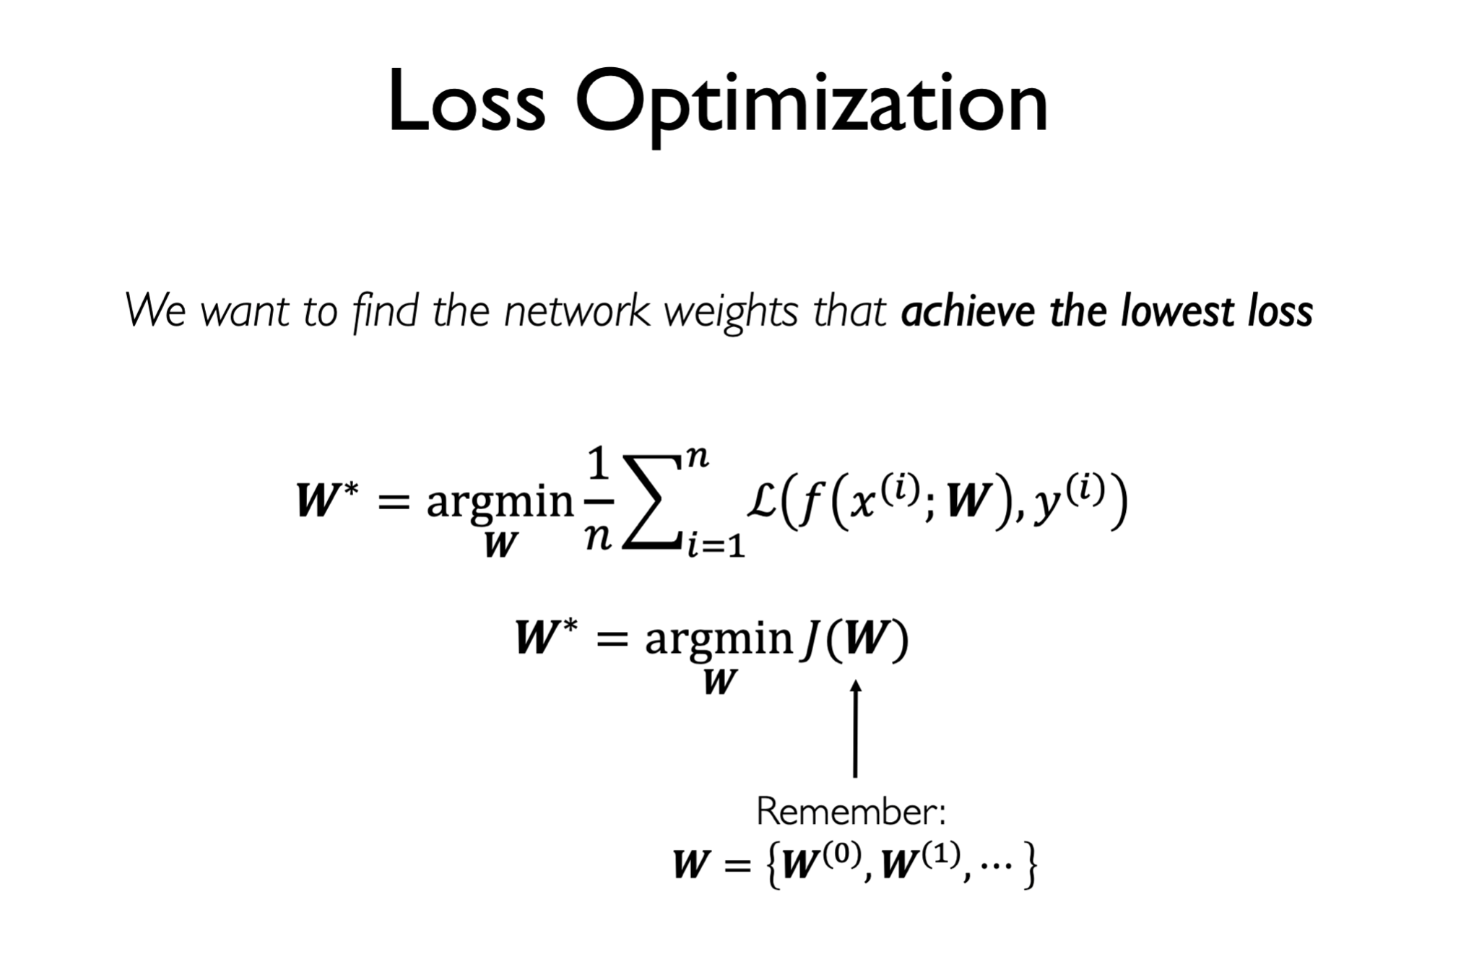
Notes:
W is your weight matrix for every input

Slide 41
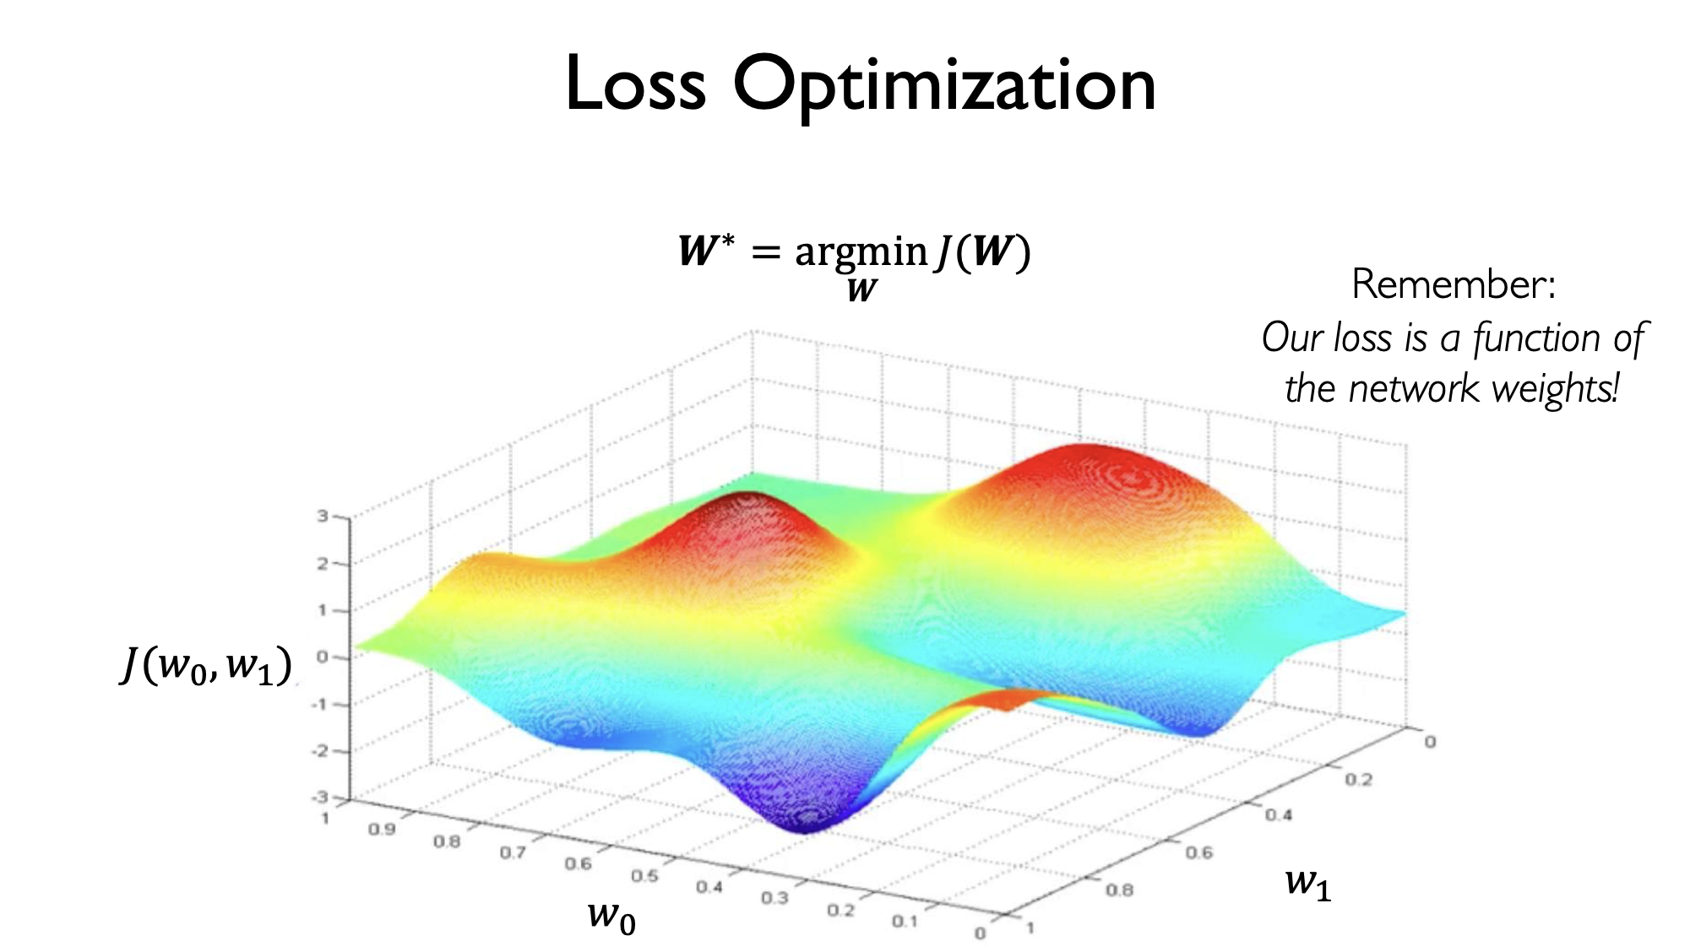
Notes:
this is what a loss function looks like
let’s unpack this graph
on the x axis you have your weight matrix for the first input
and on the z axis you have a weight matrix for the second input
y axis is your loss
space of loss can get very complex and non linear as you increase the number of layers
this is a whole field in itself, how do you make the neural network robust
our goal is to find a Weight matrix on in this space where the loss is the lowest

Slide 42
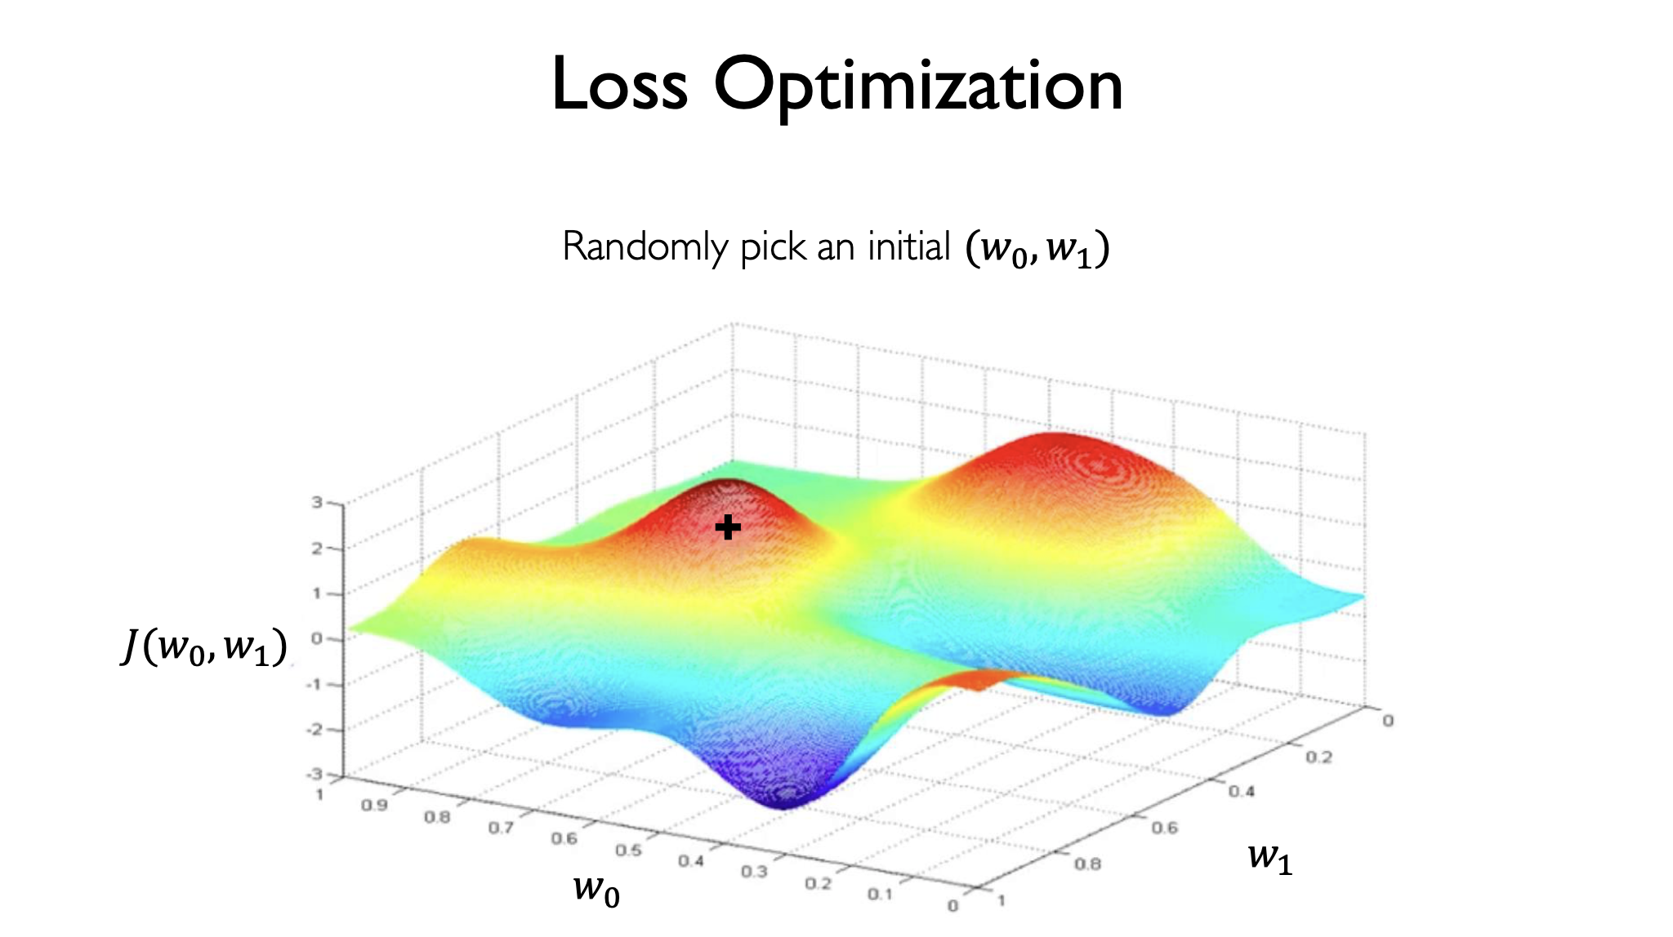
Notes:
how do we do that?
start by picking a random point in space

Slide 43
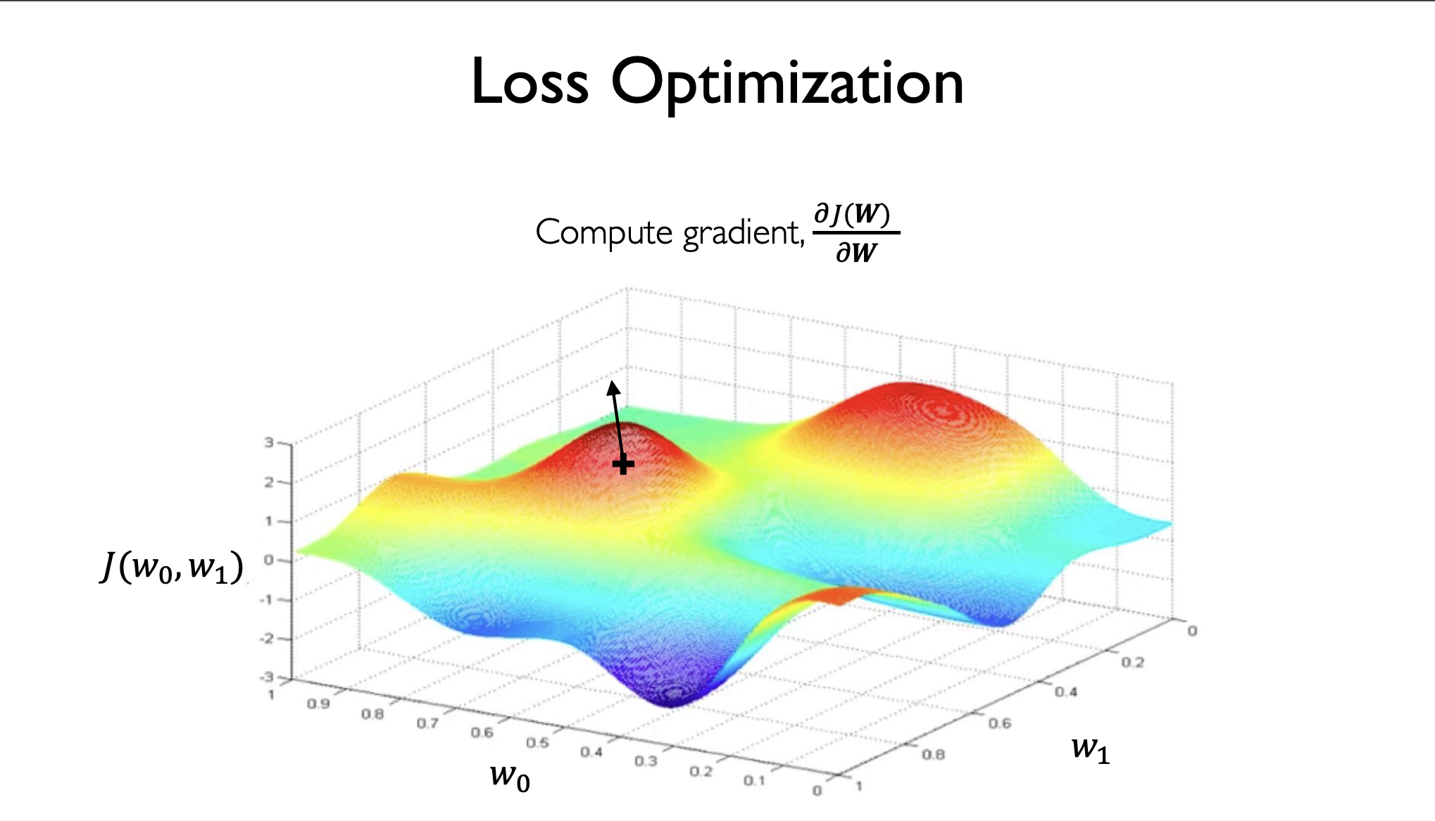
Notes:
compute the gradient J(W)/d(W)
what does this gradient represent? does anyone want to guess?
it represents how much will ht eloss function change if I tweak W
ok no problem we will cover that in a few slides

Slide 44
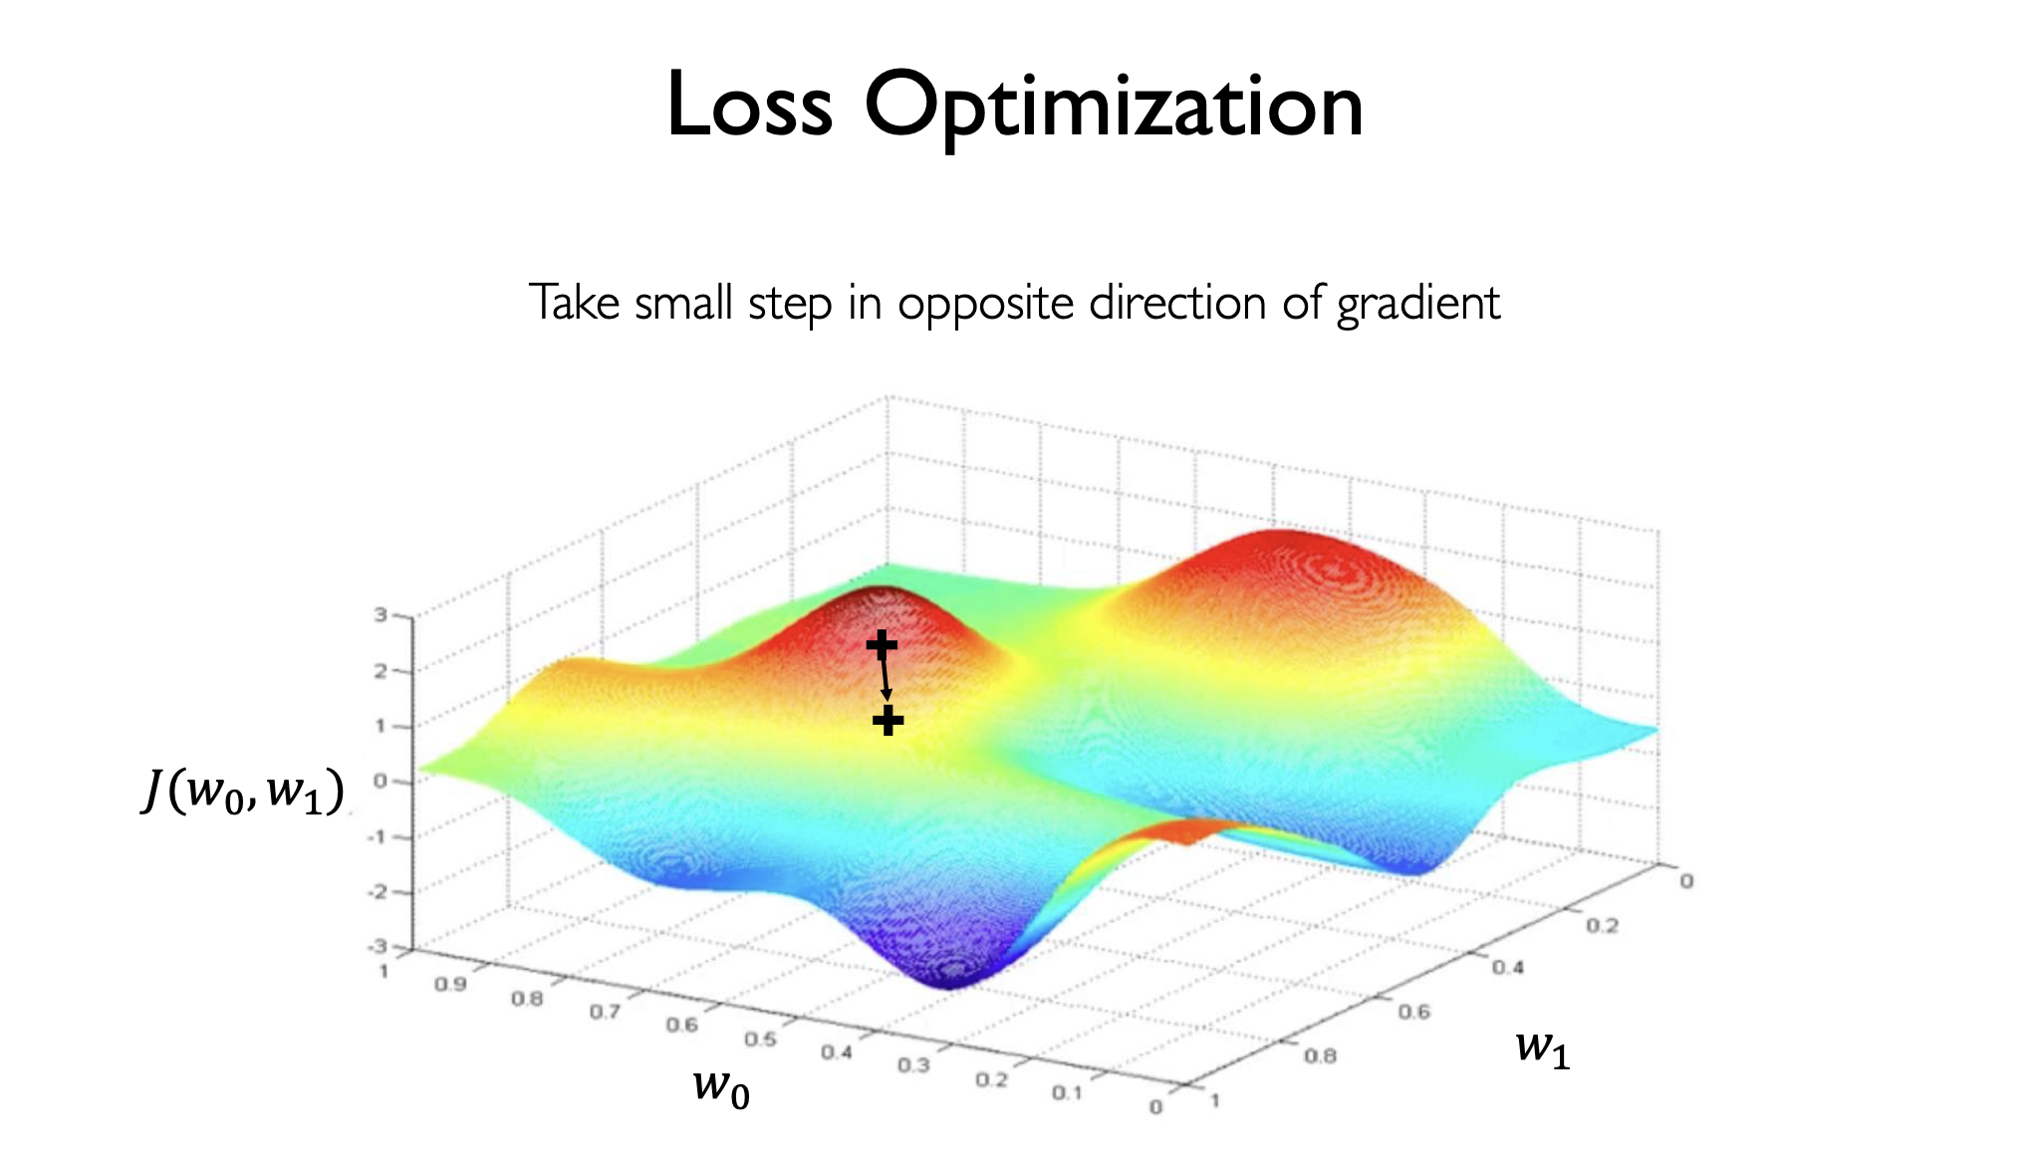
Notes:
take a small step in the direction of the gradient

Slide 45
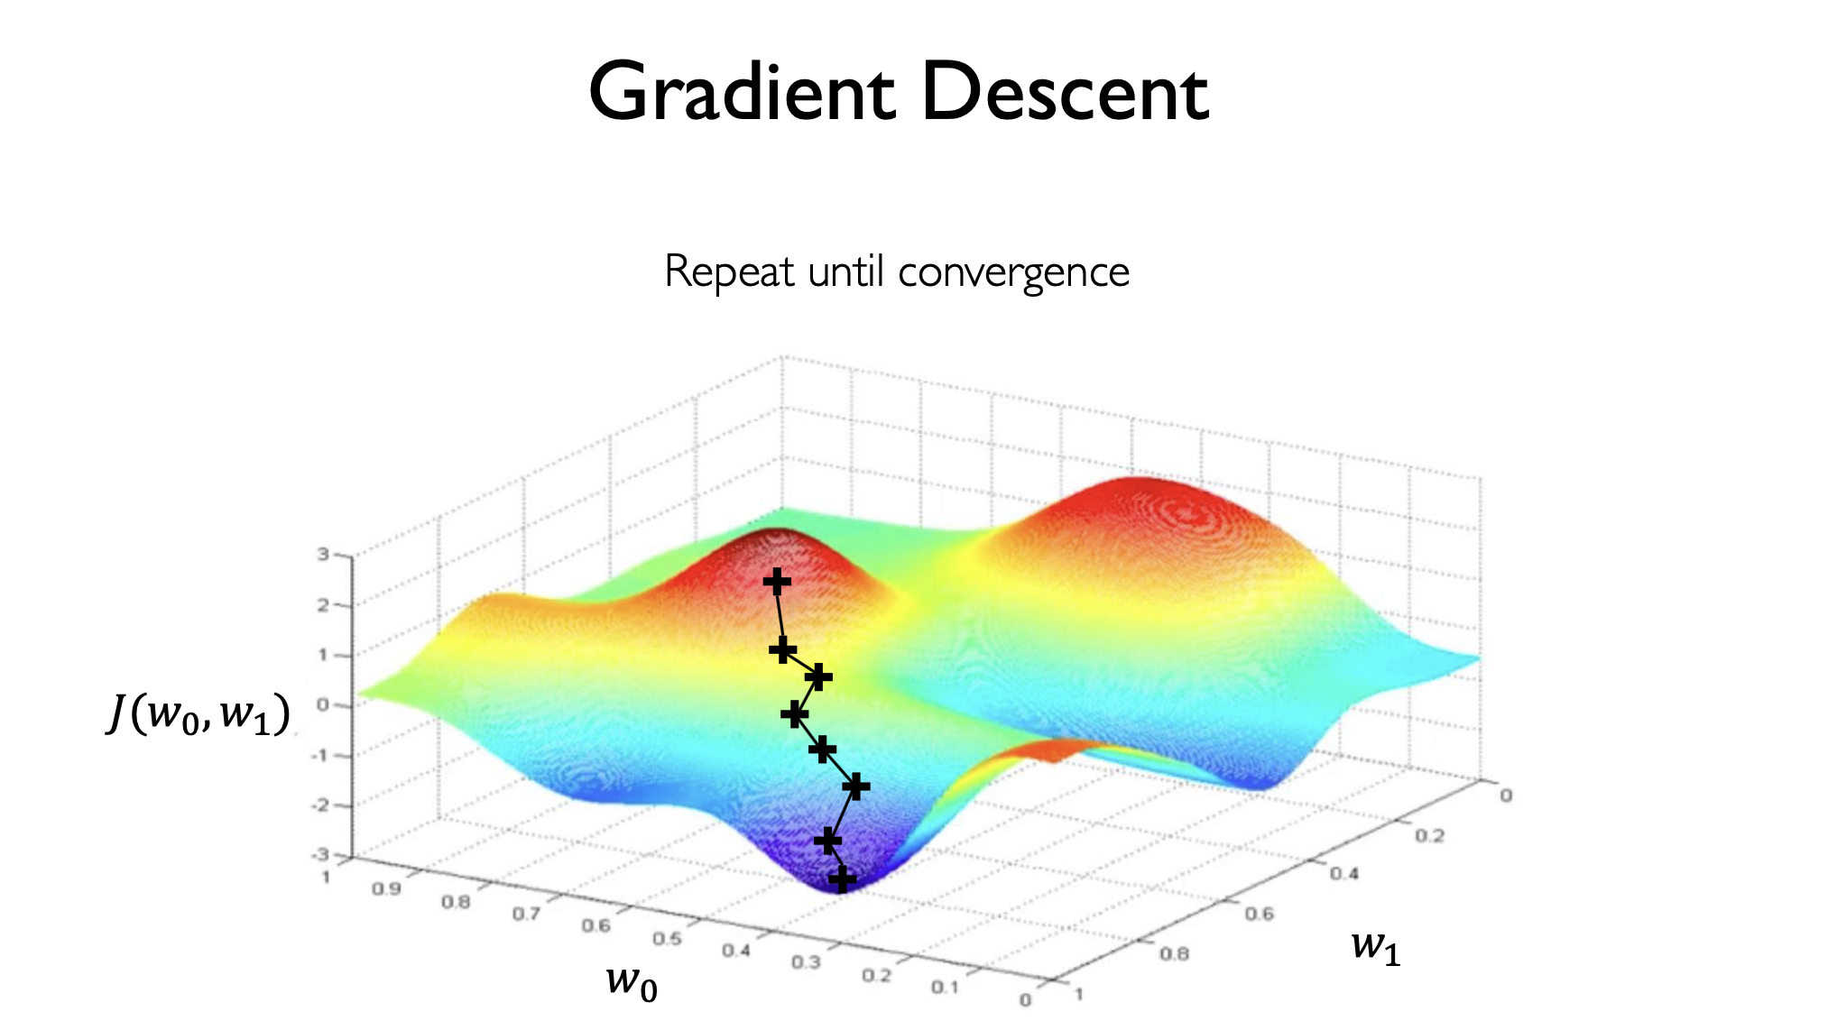
Notes:
compute the gradient again
take a step again
and in this way you keep stepping towards the gradients you take
until you converge to a minimum

Slide 46
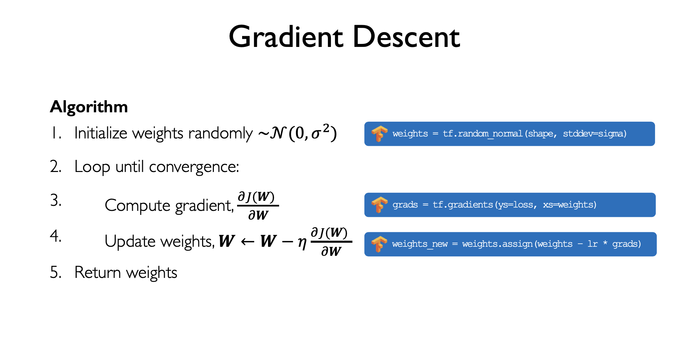
Notes:
this is essentially the gradient descent algorithm
you initialize your weights randomly
and you loop until convergence
at each step you compute the gradient
update the weights
and finally return the weights

Slide 47
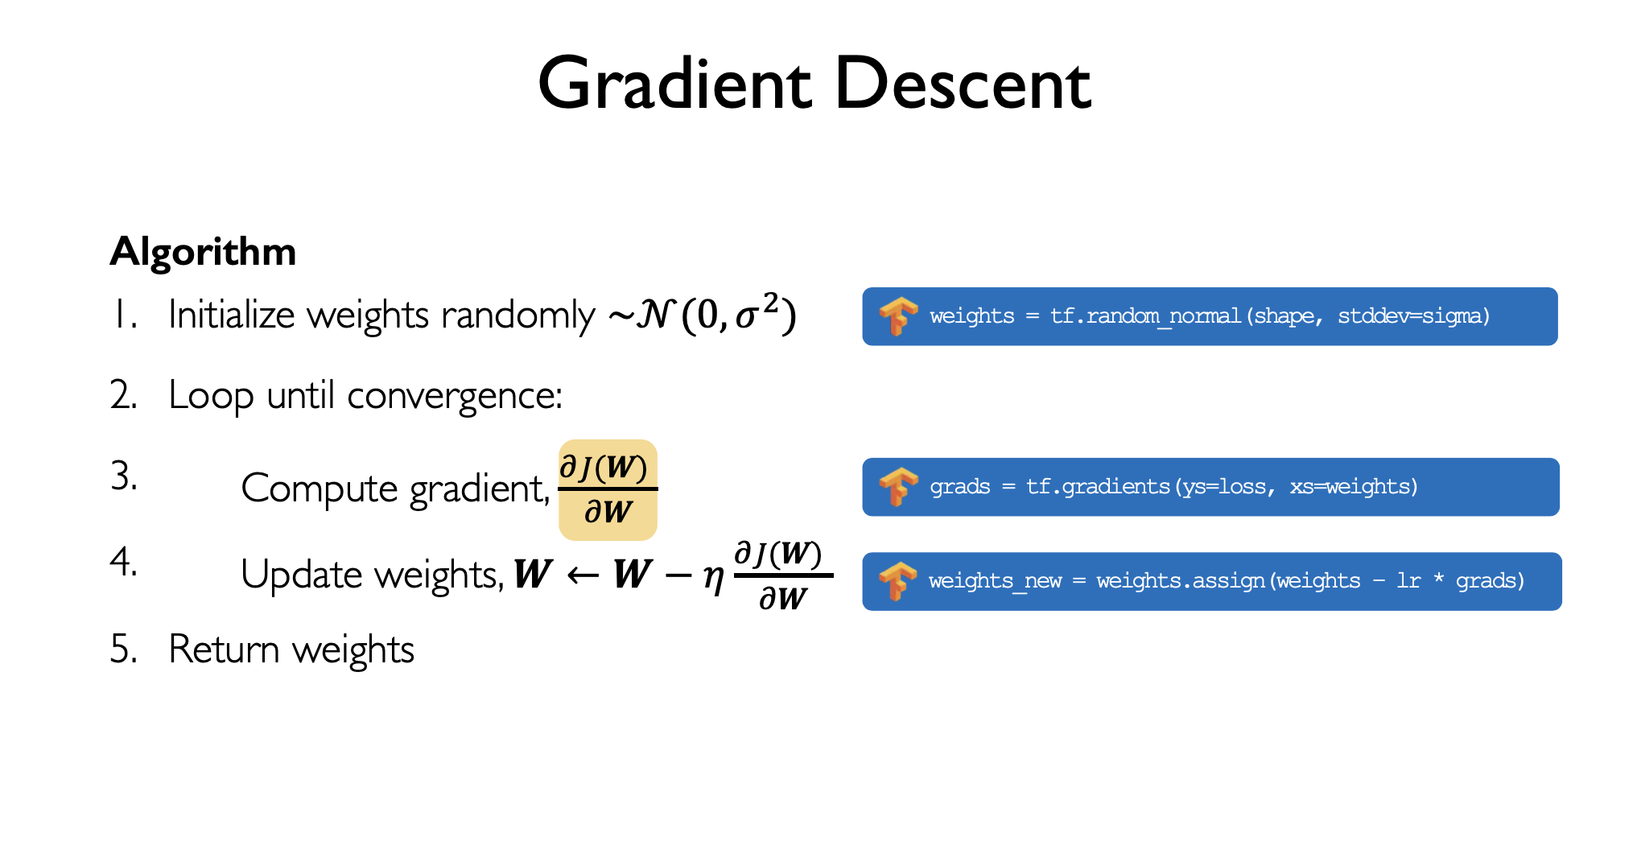
Notes:
so we say we need to compute gradients
but what does it mean to compute the gradient?

Slide 48
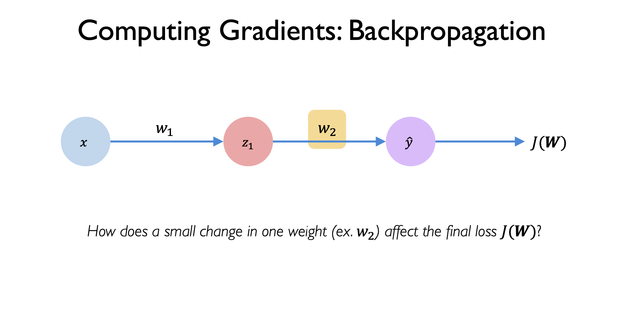
Notes:
let’s look at a simple scenario
we have an input x, and then a hidden node z1, and an output y
within this simple network you have two weight matrices one for w1 and w2
we want to find how much does a change in w2 affect the final loss J

Slide 49
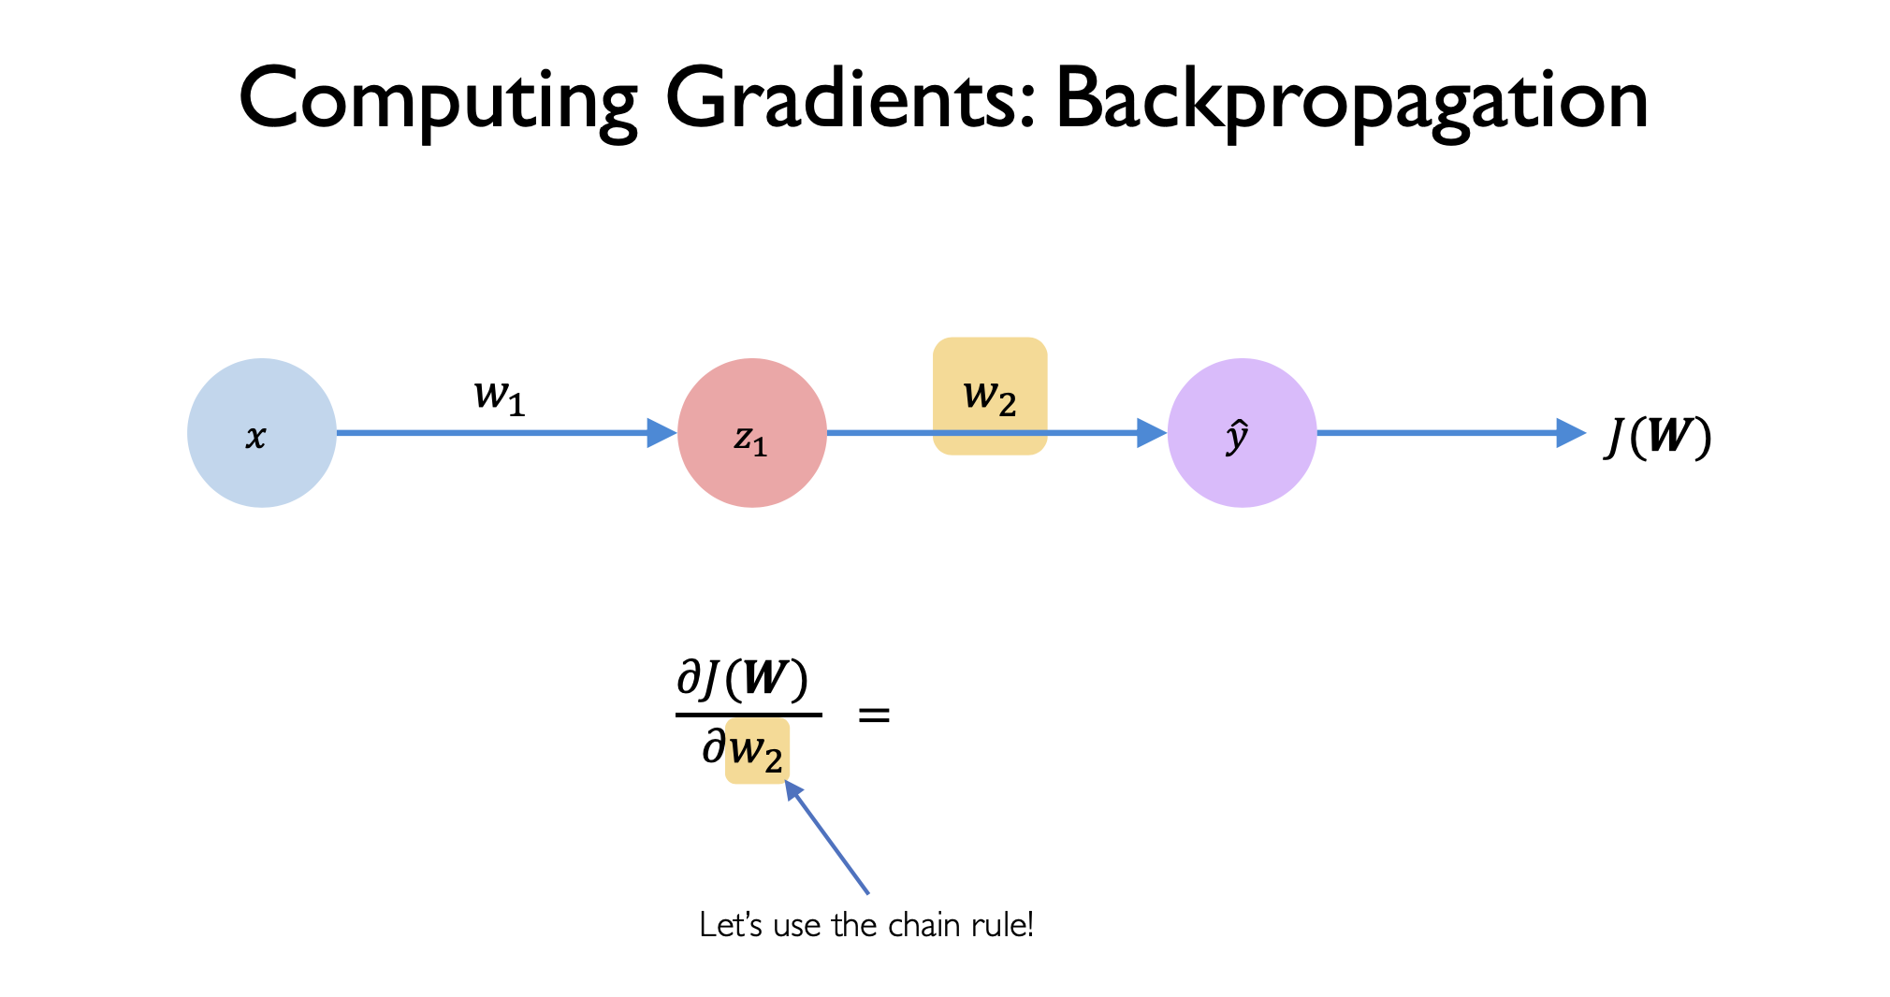
Notes:
so to do that I will compute dJ(W) with respect to dw2
can i get a show of hands of how many of you did chain rule in high school?

Slide 50
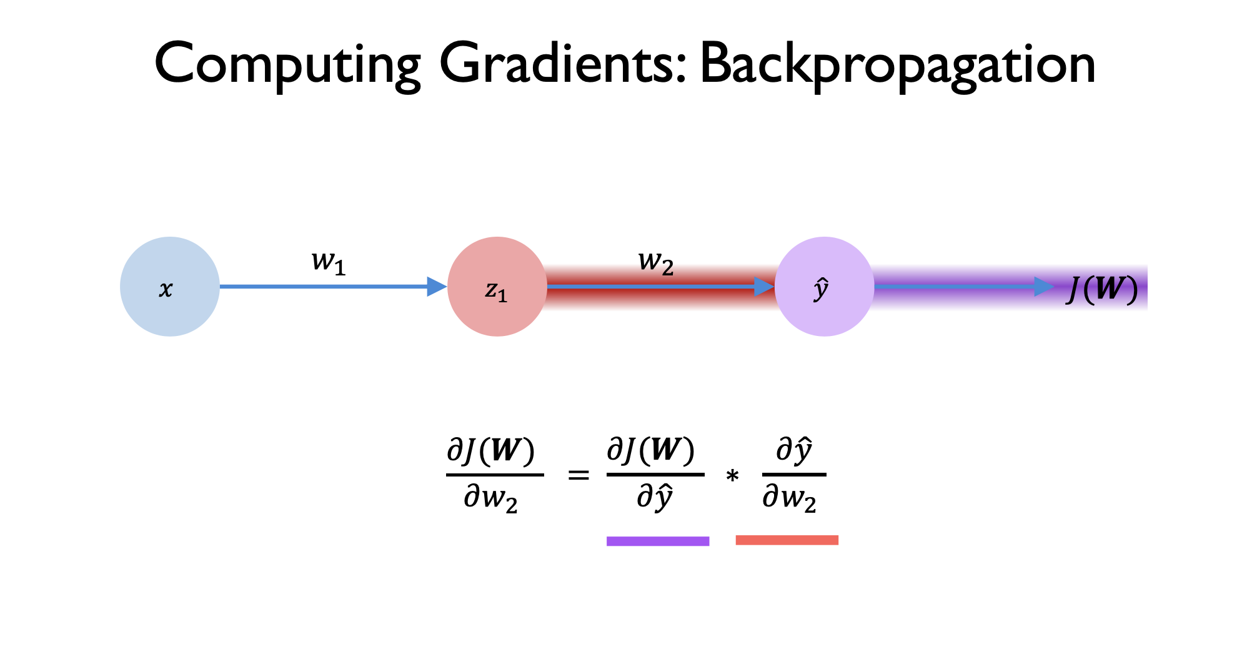
Notes:
so by chain rule you can write dJ/dw2 in terms of y^ if you also differentiate y^ wrt w2
now what this says is how much will J change if you tweak y
and how much will y change if you tweak w2

Slide 51
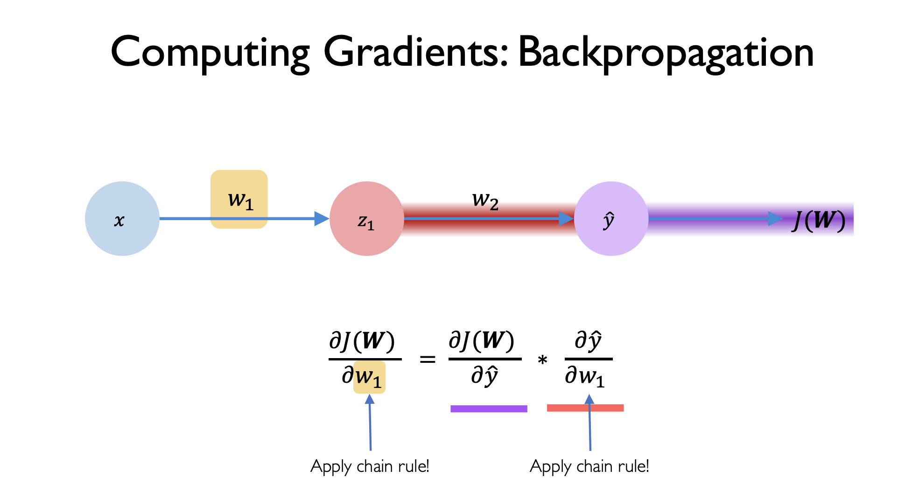
Notes:
what will happen to J if you tweak w1?
now you can find the gradient dJ/dw1 and write that in terms of y^ and w1

Slide 52
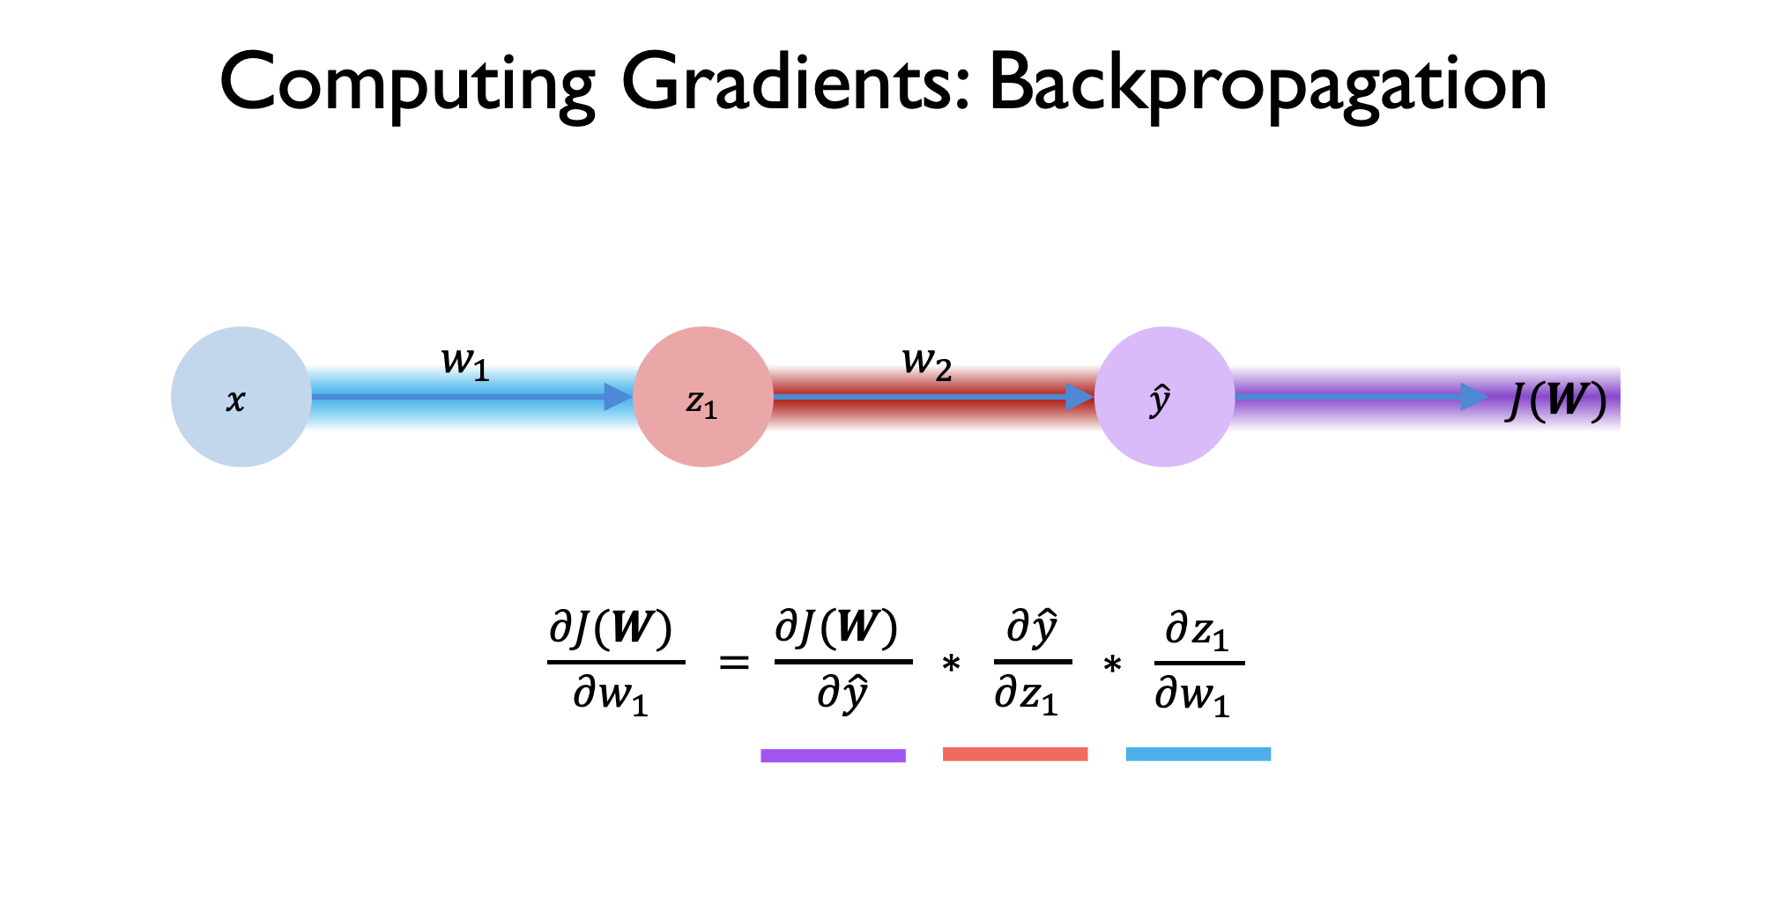
Notes:
there we applied chain rule to the second term
so we change

Slide 53
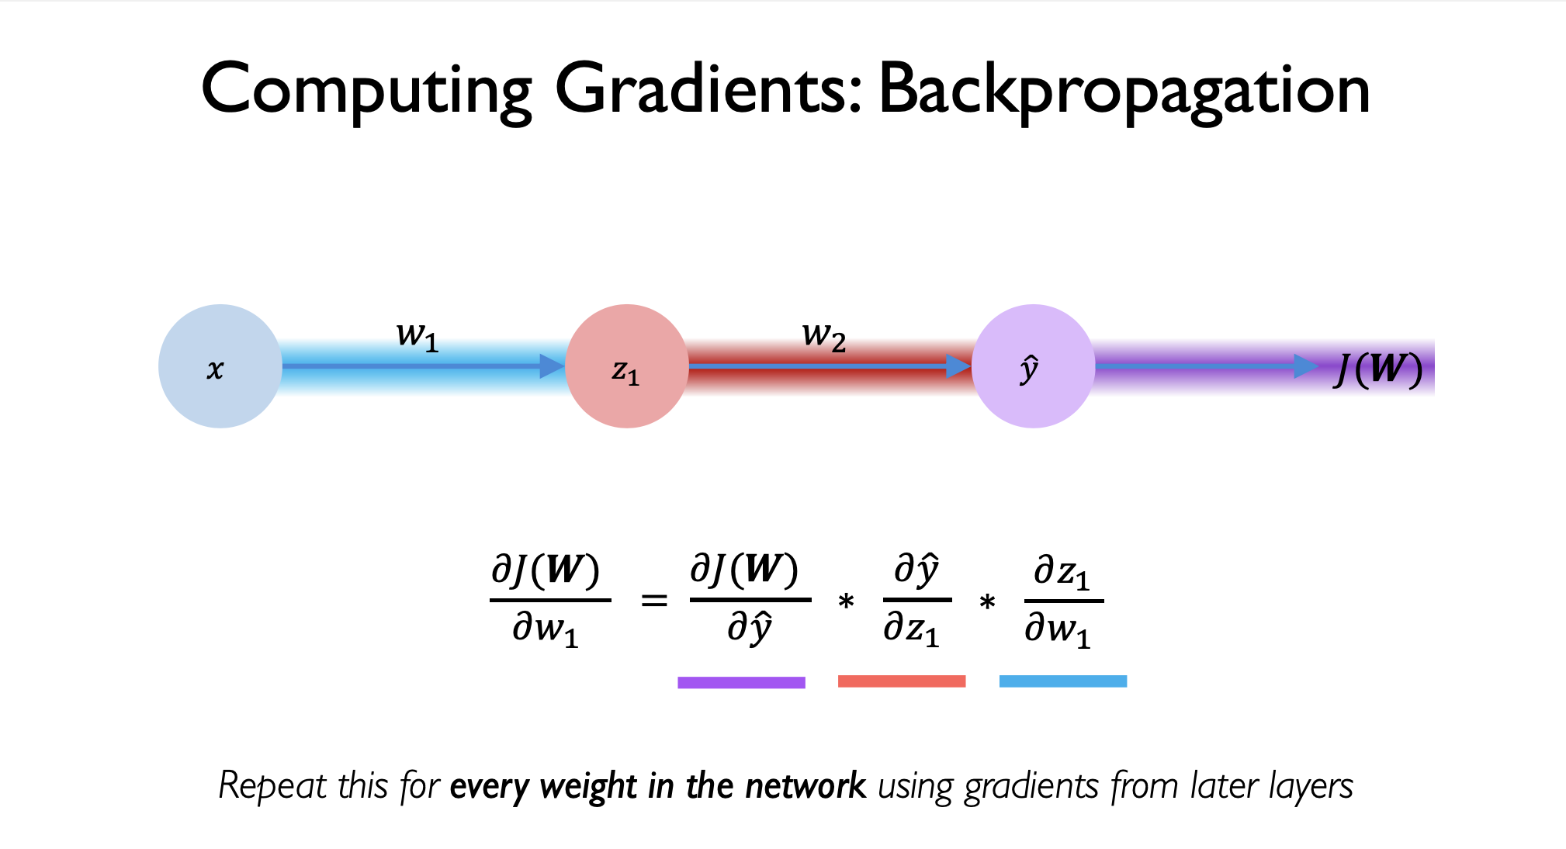
Notes:
we repeat this for every weight matrix in the network using the gradient from the later layers
this is called backpropogation algorithm
because you are propogating gradients backwards
this is the essense of deep learning
any questions so far?
ok so to summarize, we looked at how to compute loss, then we looked at how our goal is to minimize loss, and we saw how the backpropogation algorithm helps us minimize loss by taking small steps in the direction towards the minimum
now what is next?

Slide 54
Training & Validation
Split your dataset into training and validation datasets
Training:
pass input through model
get model predictions
compare to ground truth values using a loss function (training loss)
compute accuracy (training accuracy = correct_predictions/total_predictions)
backpropagate to adjust weights
repeat for N iterations
Validation
hide labels of validation dataset
use trained model to make predictions on this data
compare to ground truth values using loss function (validation loss)
compute validation accuracy (validation accuracy = correct_predictions/total_predictions)
repeat for N iterations
No backpropagation in validation.
Notes:
let’s tie it all together
so in practice
there is a bit more to computing gradients and doing backprop
any questions so far?

Slide 55

Notes:
ok so what happens after you train for N iterations
on this graph you have the iterations on x axis
and on y axis you have loss and accuracy
there are four kinds of lines here, train loss, train acc val loss and val accuracy
so first of all what is the difference between loss and accuracy?
accuracy is how many right you got out of the total number of samples
loss as we saw can be more complicated, it can be mean squared error or cross entropy
and we have training and validation steps
so what we see here is that the training loss decreases over time
and the training accuracy in orange increases over time
validation loss is dreasing over time
and validation loss is increasing over time
so intuitively yes if the training loss is decreasing that means the model is training, it is learning something
but is it learning the right thing? that we can find out by looking at the validation accuracy and training accuracy
you can see they are both very close to each other, and they are both increasing towards 100% this means that the model is making mostly correct predictions
and you can see the validation loss is also decreasing from 100% to 0%
validation curves are crucial because remember you did not give the model labels for validation

Slide 56
5 min break
Notes:
open your colab notebooks

Slide 57
Colab Notebook
Notes:
open your colab notebooks

Slide 58
Survey of Deep Learning

Slide 59

Computer Vision
Facial Recognition
Road Detection
Self-Driving Cars

Slide 60

Natural Language Processing
Voice Assistants
Social Robots

Slide 61

Social Networks
Fake News Detection
Friend Recommendations
Misinformation
Privacy

Slide 62

Reinforcement Learning

Slide 63

Protein Folding

